Slide 1

Data Follow Up

Slide 2
Historic Annual Student Headcount
Silicon Valley Colleges, 1993-2021

Slide 3
Historic Term Headcount
Evergreen Valley College, 1992-2021

Slide 4
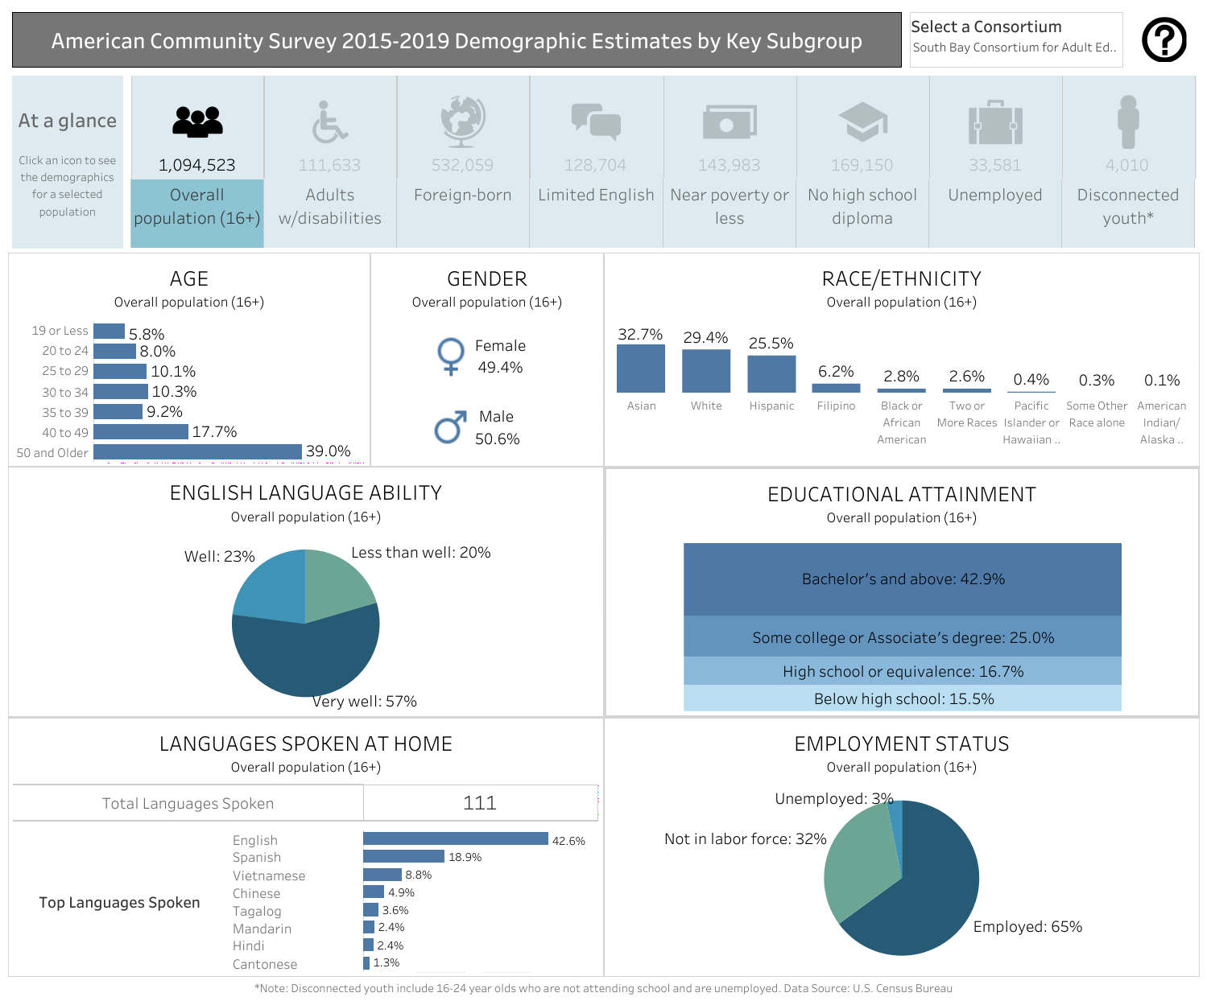

Slide 5
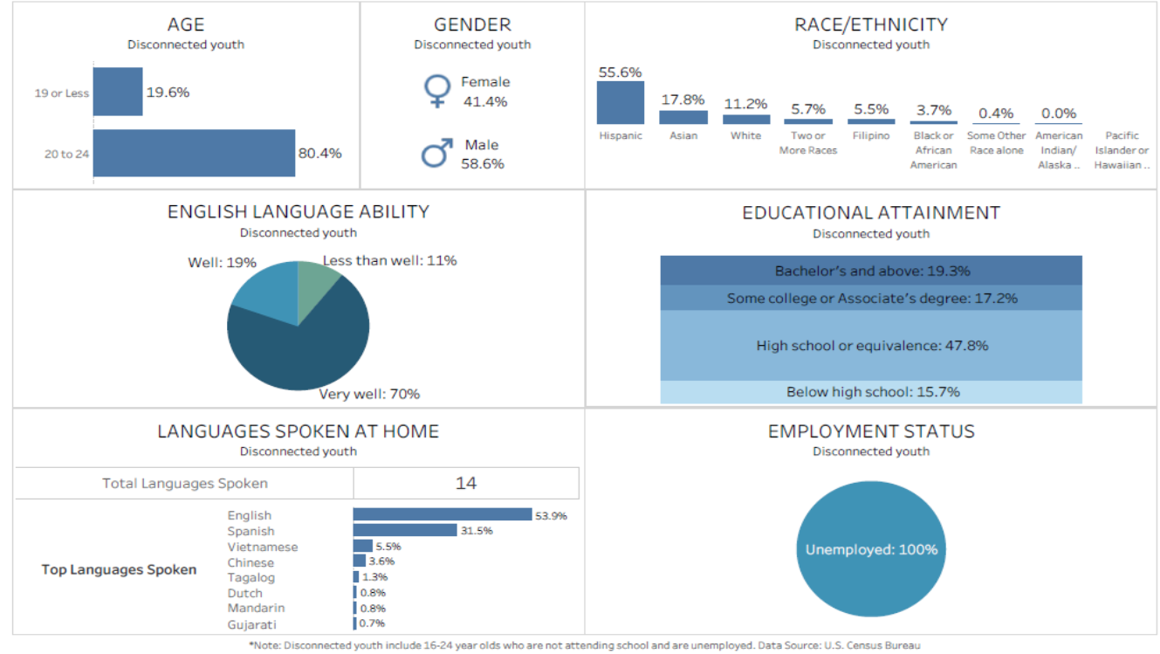
Disconnected Youth (South Bay Adult Education Consortium)

Slide 6
Comparative Demographics, 2019 estimates
US Census Data
 | San Jose | Santa Clara County | California | USA
Population 2019 | 1 million | 1.9 million | 39 million | 328 million
Under 5 | 6.1% | 5.8% | 6.0% | 6.0%
Under 18 | 22.4% | 21.6% | 22.5% | 22.3%
Over 65 | 12.5% | 13.9% | 14.8% | 16.5%
White (not Latinx) | 25.7% | 30.6% | 36.5% | 60.1%
Asian | 35.9% | 39.0% | 15.5% | 5.9%
Latinx | 31.6% | 25.0% | 39.4% | 18.5%
Foreign Born | 39.7% | 39.2% | 26.8% | 13.6%
Language other than Engl @home | 57.2% | 53.0% | 44.2% | 21.6%

Slide 7
Comparative Demographics, 2019 estimates
US Census Data
 | San Jose | Santa Clara County | California | USA
Persons per household | 3.12 | 2.95 | 2.95 | 2.62
Per capita income | $46,599 | $56,248 | $36,955 | $34,103
In poverty | 8.7% | 6.1% | 11.8% | 11.4%
Median gross rent | $2,107 | $2,268 | $1,503 | $1,062
BA+ | 43.7% | 52.4% | 33.9% | 32.1%
Households w/computer | 95.2% | 96.0% | 93.0% | 90.3%
w/broadband internet | 91.2% | 91.8% | 86.7% | 82.7%

Slide 8
Population and Projections
Santa Clara County, 2010-2060

Slide 9
Population and Projections by Ethnicity
Santa Clara County, 2010-2060

Slide 10
12th Grade Enrollment Projections
Santa Clara County Public Schools

Slide 11
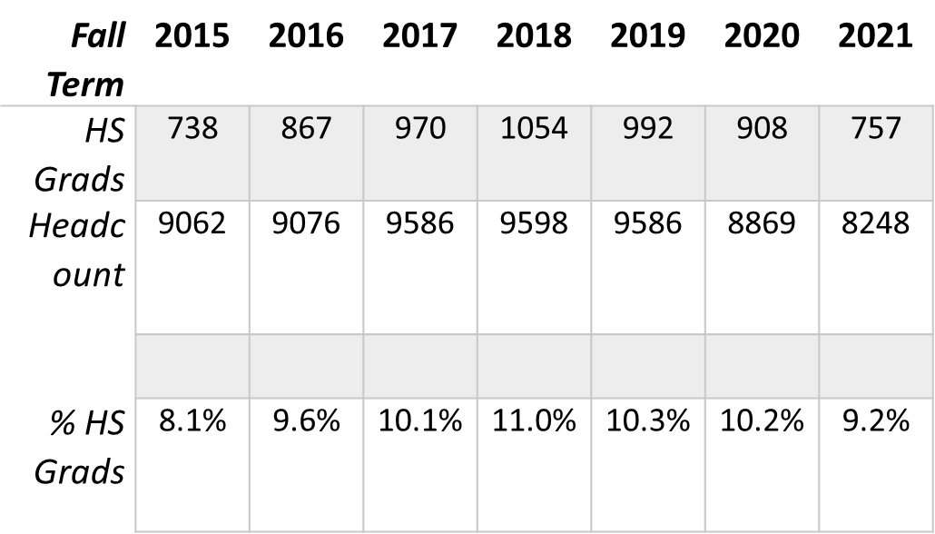
Percent of Recent High School Graduates Enrolling at EVC

Slide 12
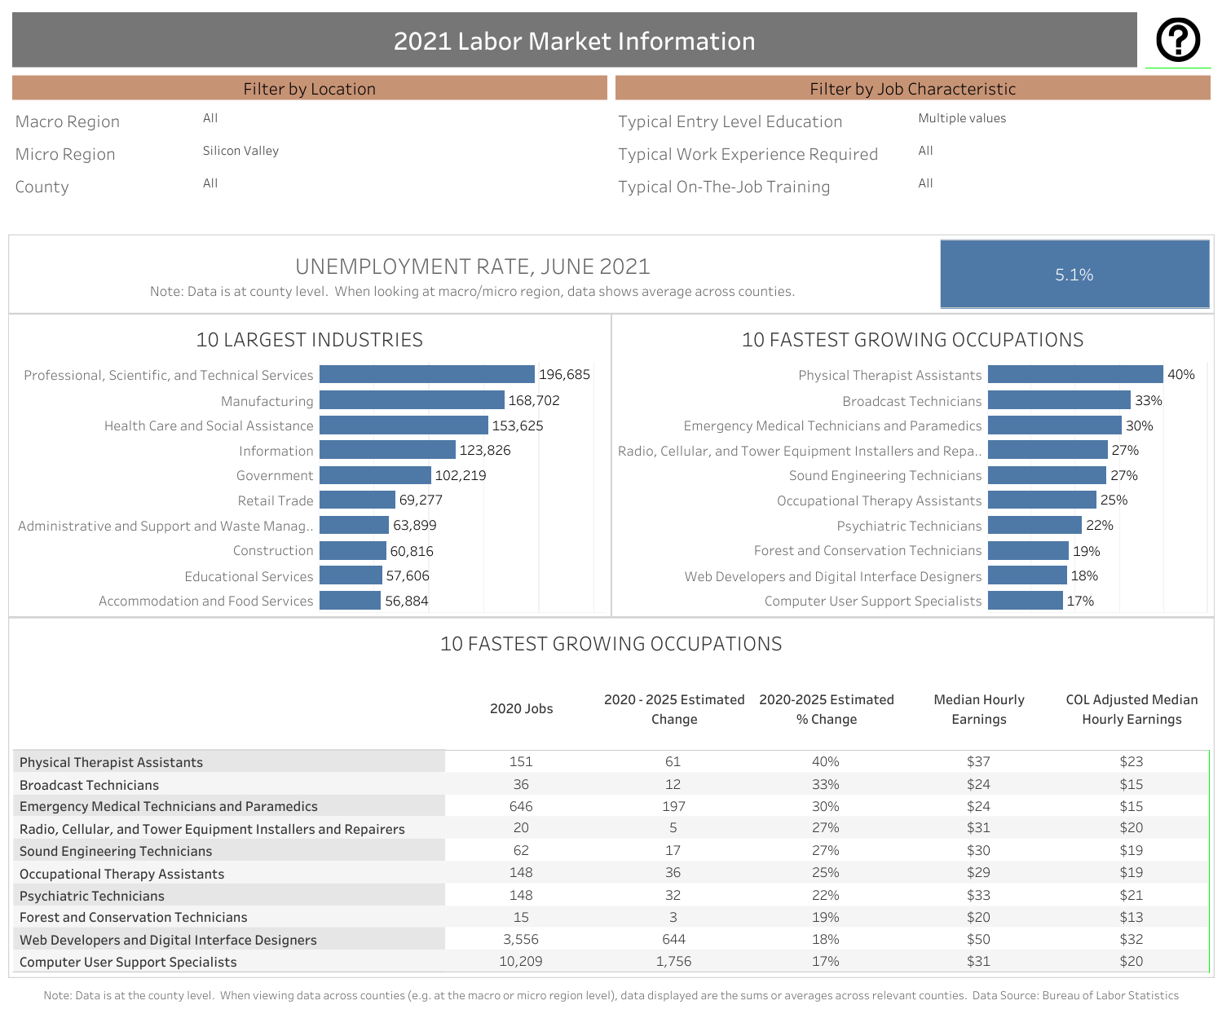

Slide 13

Questions?
Comments?

