Slide 1
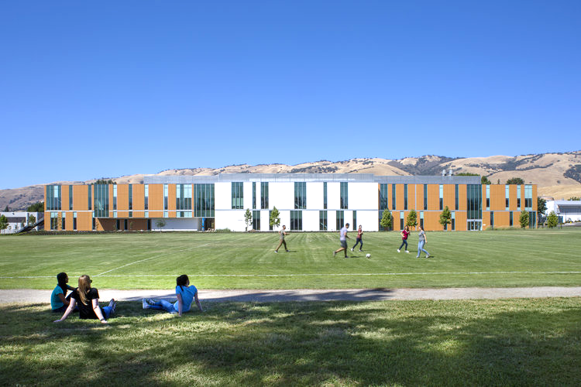
Student equity GOALS
June 11, 2019
Dean of Student Success, Victor Garza | EOPS Specialist, Sarai Minjares | Supervisor of Student Success, Song-Ho Tran

Slide 2
STUDENT EQUITY GOALS
Metrics set by the State Chancellor's Office:
Access; Enrollment into the Same College
Retention; Retained from Fall to Spring at the Same College
Certificates & Degrees; Attained the Vision Goal Completion Definition
Transferred to a Four-Year Institution
Completed Both Transfer-Level Math and English Within the District in the First Year

Slide 3
STUDENT EQUITY GOALS
Goals established by the College
Align with existing plans and priorities
Use Student Success Metrics dashboard
Review baseline data and set goals
Timeline to achieve goals by 2021-22
Use participatory governance process
Board of Trustees approval
June 30th, 2019 submit plan to the CCCCO

Slide 4
STUDENT EQUITY: the data
Percentage of students who met the student equity metric for 2017/2018:
Summary of EVC Disproportionately Impacted (DI) Groups | State Avg. | EVC Overall Avg. | Veterans | Foster Youth | Pacific Islander/ Native Hawaiian | Hispanic/Latino | Black/ African American | American Indian/ Alaska Native | Students with Disabilities
Access | 48% | 47% | 36% | 34% | 34% |  | 38% | 36%
Retention | 67% | 66% |  |  |  |  | 59%
Certificates/ Degrees | 5.9% | 4.9% |  | 3.3% | 2.4% |  |  |  | 3.7%
Transfer to a 4-Year University* | 5.8% | 7.2% |  |  |  | 5.6% |  |  | 6.5%
Transfer-Level Math/English | 8% | 9% |  | 0% |  | 7% | 2% | 0% | 4%
Note: Blank data elements represent EVC student groups that are not disproportionately impacted for the specific metric
* 2016/2017 baseline year

Slide 5
STUDENT EQUITY GOALS
Among all students, increase the number of: | Baseline Year 2017-18 | Target Year 2021-22 | % Increase
Access; Enrollment into the Same College | 9,226 | 9,410 | 2%
Retention; Retained from Fall to Spring at the Same College | 6,085 | 6,454 | 6%
Certificates & Degrees; Attained the Vision Goal Completion Definition | 647 | 766 | 18%
Transferred to a Four-Year Institution* | 940 | 1,035 | 10%
Completed Both Transfer-Level Math and English Within the District in the First Year | 198 | 297 | 50%

Slide 6
Equity Goal Setting
Disproportionately impacted(DI) groups identified based on baseline year data for each metric.
The analysis included the equity groups identified in Ed Code 78220 (where data were available).
Goal setting required for impacted groups except when baseline data are made unavailable to protect privacy or low sample sizes.

Slide 7
Summary of Student Equity Data: Females
Subgroup (Gender: Female) | Access | Retention | Attained the Vision Goal Completion | Transferred to 4-year Institution | Completed College-Level Math & English in 1 Year
Hispanic/Latino | DI | DI
Black/African American | DI |  | DI
Pacific Is./Native Hawaiian | DI
Foster Youth | DI
Students with Disabilities |  |  |  |  | DI
Veterans

Slide 8
Summary of Student Equity Data: Males
Subgroup (Gender: Male) | Access | Retention | Attained the Vision Goal Completion | Transferred to 4-year Institution | Completed College-Level Math & English in 1 Year
Hispanic/Latino |  | DI | DI | DI | DI
Black/African American | DI | DI
Pacific Is./Native Hawaiian
Foster Youth | DI
Students with Disabilities |  |  | DI | DI
Veterans | DI

Slide 9
Aligned resources & programs
THE TOOLS
EVC Student Support Programs and Services
THE HOW
Activities
*Increase Access
*Increase Retention
*Increase Certificates/Degrees
*Increase Transfer to 4-Yr Institution
*Increase the Number of Students Who Complete Transfer Level Math and English in First Year
THE WHAT
THE WHY
Our Students and Communities

Slide 10
THE TOOLS
Student Support Programs and Services
AFFIRM
ASPIRE
Business and Workforce
Campus Tutoring
Career & Hygiene Closet
DSP
Early Alert
Enlace
EOPS
EVC First Stop Center
EVC Hawk Food Pantry
Mental Health Services
Non-Credit
OASISS
Probation/Dismissal Intervention
SEASSE
Transfer Center
Veterans
YESS

Slide 11
THE HOW
Campus-wide Activities
Expanded Outreach
EVC’s First Stop Onboarding Center
Student Ambassadors
Community Partnerships/Events
Special Programs Onboarding
Intervention & Follow Up: Early Alert & Back to Success
Designated Safe Places/Centers
Priority Registration
Counseling Courses
Special Programs Wrap-Around Services
Workshops
Reviewing certificate/degree eligibility for students with high units
CTE Programs & MOU/Partnerships
Guided Pathways
Strong Workforce
Special Programs Counseling
Transfer Center Advisory Board
Transfer Events and University Trips
University Reps on Campus
HBCU & Other Special Program Events (e.g. cultural awareness, academic success celebrations)
Tutoring: Embedded, Supplemental, Special Program
Self-Guided Placement Tool
Co-requisite Courses
Math Bridge Programs: Enlace, AFFIRM, East Side Union Alliance

Slide 12
THE HOW
Community Partnerships (e.g. FYSI for Foster Youth)
Special Programs Onboarding
Special Programs Outreach to DI Populations
Community Events (e.g. HBCU Caravan)
Academic Special Programs Course Enrollment
Designated Safe Place Centers
Early Alert for AB 705
Transfer and Career Field Trips
Special Programs Wrap-Around Services (e.g. Book Vouchers/Loans)
Special Programs Multilingual Counseling Services
Tutoring: Embedded, One-on-One, Supplemental Instruction
Math Summer Bridge (e.g. Enlace, UMOJA-AFFIRM)

Slide 13
THE WHY

Slide 14
THANK YOU!
A special Thank You to
Dean of Research, Planning & Institutional Effectiveness, Jaqueline Honda
& EVC Research Analyst, Hazel De Ausen

