Slide 1

Equity, Opportunity and Social Justice
STUDENT EQUITY PLAN
UPDATE
Presenter: Angelina Duarte
December 8, 2015

Slide 2
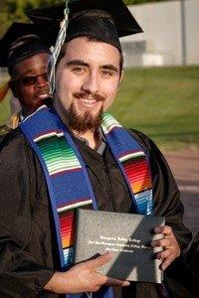
MOVING FORWARD
2015/2016

Slide 3
LINKING SERVICES TO SUPPORT STUDENT ACHIEVEMENT

Slide 4
Five Success Indicators
Access
Course Completion
ESL and Basic Skills Completion
Degree and Certificate Completion
Transfer

Slide 5
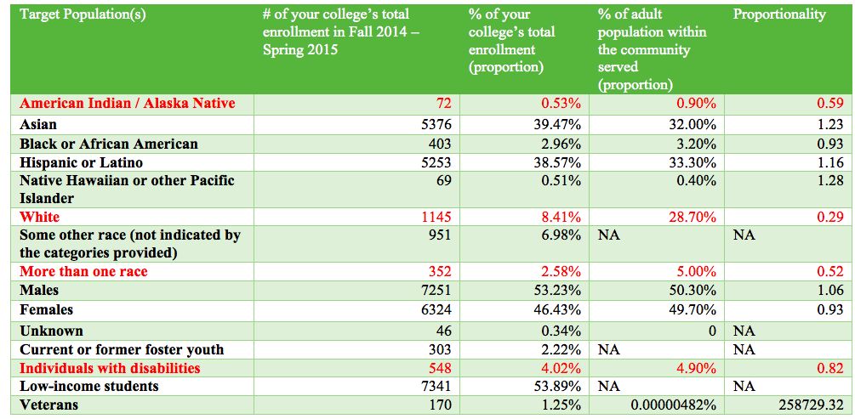
Access

Slide 6
Activities to Address Access
($73,400)
To increase the number of admitted students who are underrepresented based on our surrounding population, which include Native Americans, White students and students with disabilities.
To strengthen relations with local high schools, adult education and community agencies with special emphasis on those providing services to Veterans, foster youth, and students with disabilities.
Collaborate with high schools on developing strategies to increase students’ career and college readiness.
Strengthen Assessment Center by adding staffing and equipment resources, including providing LD assessment services.
Create a stronger presence and message via effective marketing of our degrees, certificates and outstanding programs.

Slide 7
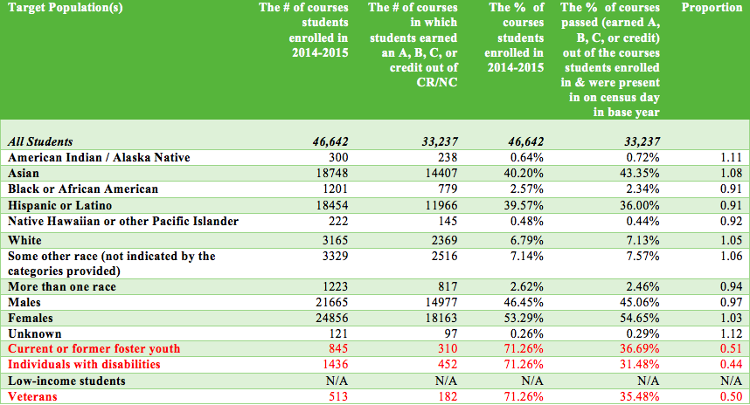
Course Completion

Slide 8
Activities to Address Course Completion
($293,635)
Build capacity to provide focused services including timely intervention, follow-up, support curriculum and intensive & preemptive tutoring.
Partner with faculty to improve the Early Alert program to easily identify students needing support in order to complete their courses.
Work with the Language Arts & Math departments and tutoring coordinator to review current activity and needs in the area of supplemental instruction.
Provide additional resources to equity-based programs including categorical, special academic and emerging programs such as the Veterans Center, foster youth programs, and OASISS (AB540).
Enhance Service Learning program to provide opportunities for targeted students to engage and develop leadership and civic responsibility.

Slide 9
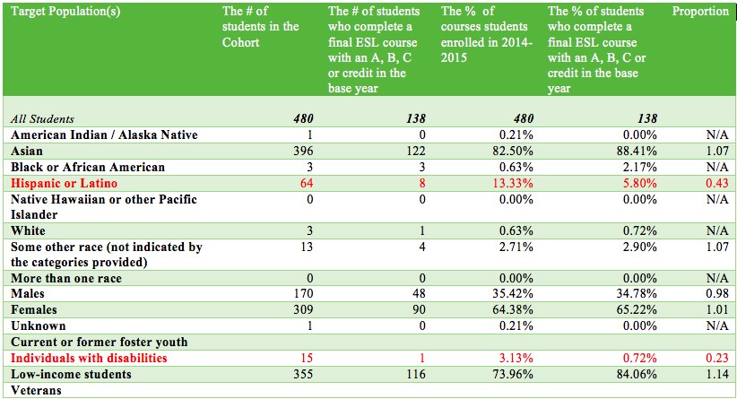
ESL and Basic Skills
Remedial ESL

Slide 10
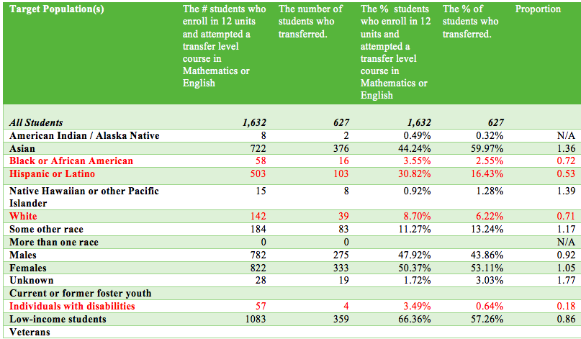
ESL and Basic Skills
Remedial English

Slide 11
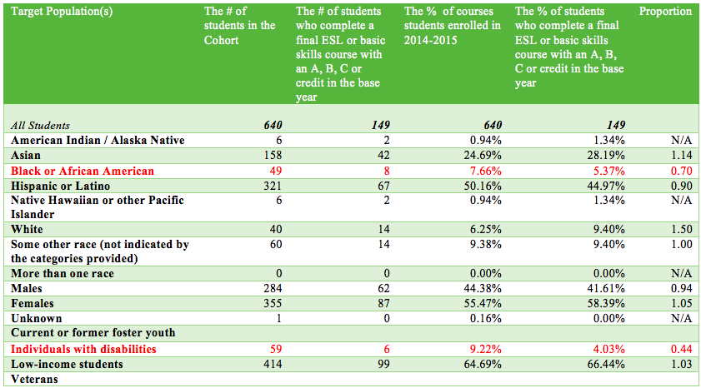
ESL and Basic Skills
Remedial Math

Slide 12
Activities to Address ESL/Basic Skills
($146,817)
Design and implement a summer bridge program for targeted high school and Adult Ed cohorts who place in lower level basic skills.
Work with English and Math departments to coordinate Student Equity and Basic Skills Initiative resources to fill unmet needs.
Provide resources and opportunities for Basic Skills curriculum redesign to improve and accelerate transition into transfer level college work.
Provide resources to English and Math faculty to discuss and explore opportunities with high school faculty to improve curriculum alignment and provide a seamless transition for students.
Provide resources to enhance supplemental instruction in Basic Skills courses
Identify and hire language specific tutors for ESL Students including reaching out to graduate students in a teacher credential program.

Slide 13
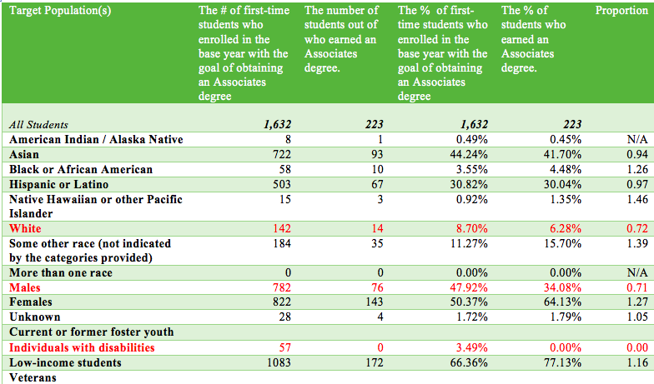
Associate Degree Completion

Slide 14
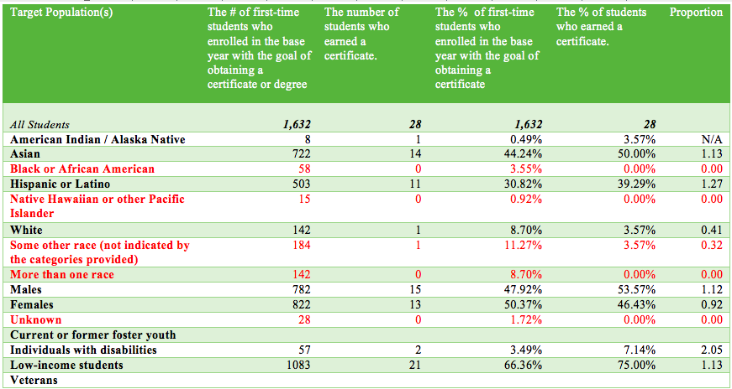
Certificate Completion

Slide 15
Activities to Address Degree Certificate Completion
($73,400)
To create research reports that would provide information on students who have completed degrees and certificates but have not petitioned for one and students who initially identified a degree or certificate as a goal but changed their educational goal.
To identify and survey students who indicated a degree or certificate as a goal but did not complete it.
Provide additional academic counseling to equity-based programs including categorical, special academic and emerging programs such as the Veterans Center, foster youth programs, and OASISS (AB540), with special focus on students with disabilities.
Work with Workforce Development to provide specialized comprehensive counseling services to Career Technical Students pursuing a certificate or Associates of Arts or Sciences Degree.
Hire LD Specialist to improve degree and certificate completion by providing students with interpretive diagnostic tests, making appropriate educational recommendations, academic accommodations and teaching specialized success courses for DSP students.

Slide 16
Transfer

Slide 17
Activities to Address Transfer
($146,817)
To expand student transfer services, enhance student transfer awareness and increase transfer rates campus-wide for AB540 students, Veterans, foster youth and students with disabilities.
Work with Enlace, Affirm and Aspire to provide Latino(a), African American and Asian students with additional counseling, specialized transfer workshops and intentional follow-up to improve transfer rates.
Provide students with disabilities who want to transfer interpretive diagnostic tests, specialized counseling, accommodations and specialized success courses.
Implement degree audit to facilitate the transfer process for counselors and students.
Provide in-residence transcript evaluation and strengthen relations with A&R to provide a clear pathway for transfer students.
Revisit all transfer services to increase collaboration and coordination to provide clear information to transfer-bound students in multiple languages.
Expand Transfer & Career curriculum and increase coordination of transfer services.
Purchase a variety of interest inventories/personality assessments to assist students in clarifying their transfer goal.

Slide 18
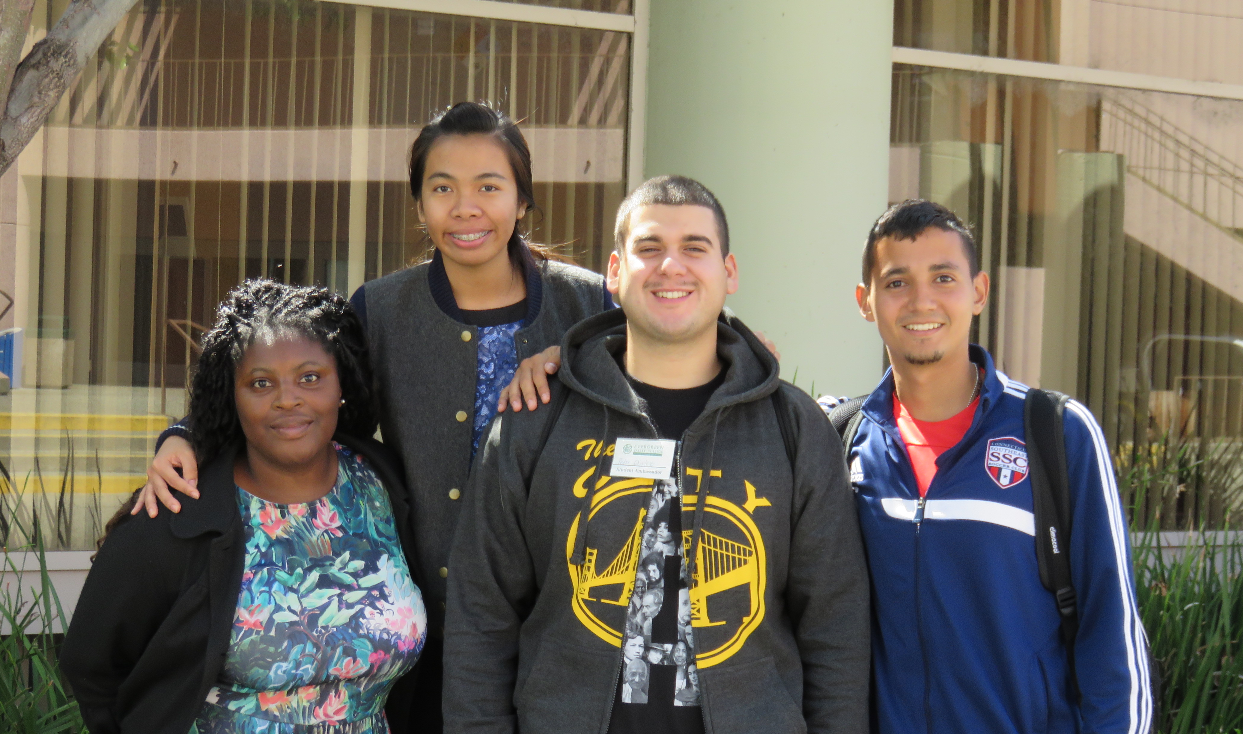
THANK YOU FOR BELIEVING IN US

