Slide 1

EVC Data Packet
With Institutional and Program Level Data

Slide 2

THE SEP DATA ON STUDENT ACCESS

Slide 3

EVC Institutional Data Indicates that:
With regard to access, there are three groups that are disproportionately impacted. This means their presence in the student population is not equitable as compared to their presence in the adult population of San Jose, California.
Those populations are:
  American Indian students
  White students, and
  Individuals with disabilities
  (*Source: Disproportionality Report, SJECCD, 2015).

Slide 4
ACCESS MEASUREMENT | NUMBER OF EVC’S TOTAL ENROLLMENTS FALL 2014- SPRING 2015 | NUMBER OF EVC’S TOTAL COLLEGE ENROLLMENT (PROPORTION) | NUMBER OF ADULTS WITHIN THE SAN JOSE COMMUNITY SERVED | PROPORTION *Note: (<.91 is a problem; >.91 is okay)
American Indian/Alaskan | 72 | 0.53% | 0.90% | 0.59
Asian | 5376 | 39.47% | 32.00% | 1.23
Black or African American | 403 | 2.96% | 3.20% | 0.93
Hispanic or Latino | 5253 | 38.57% | 33.30% | 1.16
Native Hawaiian or Pacific Islander | 69 | 0.51% | 0.40% | 1.28
White | 1145 | 8.41% | 28.70% | 0.29
More than one race | 352 | 2.58% | 5.00% | 0.52

Slide 5
TARGET POPULATION | NUMBER OF EVC’S TOTAL ENROLLMENTS FALL 2014- SPRING 2015 | NUMBER OF EVC’S TOTAL COLLEGE ENROLLMENT (PROPORTION) | NUMBER OF ADULTS WITHIN THE SAN JOSE COMMUNIT Y SERVED | PROPORTION *Note: (<.91 is a problem; >.91 is okay)
Males | 7251 | 53.23% | 50.30% | 1.06
Females | 6324 | 46.63% | 49.70% | 0.93
Unknown | 46 | 0.34% | 0 | NA
Current or Former Foster Youth | 303 | 2.22% | NA | NA
Individuals with Disabilities | 548 | 4.02% | 4.90% | 0.82
Low-Income Students | 7314 | 53.89% | NA | NA
Veterans | 170 | 1.25% | 0.00000482% | .238729

Slide 6
THE SEP DATA ON COURSE COMPLETION

Slide 7

EVC Institutional Data Student
Course Completion Trends 2013-2015
Students with Disabilities | Current Foster Youth | Veterans
The only group impacted as far as course success during 2013-2014 and again in 2014-2015. *All three of these groups need student services in the area of course success based on this data! | A new group that has been impacted during the 2014-2015 year. Foster youth pass their courses at a rate of 31%, compared to the general population at 71%. | Another new group that has been impacted during the 2014-2015 year. Veterans pass their courses at a rate of 35%, compared to the general population of 71%.

Slide 8
Course Completion Data from the SEP
Target Population | # of Courses Students Enrolled In | # of Courses Students Earned A, B, C, or Credit | The % of Courses passed with A, B, C or Credit | Total (all student) pass rate | Comparison to the all student average (percentage difference +/-).
American Indian/Alaskan | 300 | 238 | 0.64% | 0.72% | 1.11
Asian | 18748 | 14407 | 40.20% | 43.45% | 1.08
Black or African American | 1201 | 779 | 2.57% | 2.34% | 0.91
Hispanic or Latino | 18454 | 11966 | 39.57% | 36.00% | 0.92
Hawaiian/Pac. Islander | 222 | 145 | 0.48% | 0.44% | 0.92
White | 3165 | 2369 | 6.79% | 7.13% | 1.05

Slide 9
Course Completion Data from the SEP, continued.
Target Population | # of Courses Students Enrolled In | # of Courses Students Earned A, B, C, or Credit | The % of Courses passed with A, B, C or Credit | Total (all student) pass rate | Comparison to the all student average (percentage difference +/-).
More than one race | 1223 | 817 | 2.62% | 2.46% | 0.94
Males | 21,665 | 14,997 | 46.45% | 45.06% | 0.97
Females | 24,856 | 18, 163 | 53.29% | 54.65% | 1.03
Current or Former Foster Youth | 845 | 310 | 71.26% | 36.69% | 0.51
Individuals with Disabilities | 1436 | 452 | 71.26% | 31.48% | 0.44
Veterans | 513 | 182 | 71.26% | 35.48% | 0.50

Slide 10

EVC Student
Course Retention Trends
2014-2015
Congratulations! There are no underrepresented groups for Retention at EVC. The overall retention rate is 87% for 2014-2015.

Slide 11
THE SEP DATA ON ESL, BASIC ENGLISH AND MATH SKILLS COMPLETION

Slide 12

EVC Student
Trends in Remedial English Courses
2014-2015
Of the 76 students with identified disabilities, only 12 (16%) passed their final Remedial English classes taken in AY 2014-15. The overall population of students in the cohort of students who took remedial English had a pass rate of 51%.
Data collection for other at-risk groups is now being collected by the District.

Slide 13

EVC Student
Trends in Remedial ESL Courses
2014-2015
Only 12% of Hispanic Students who took ESL courses in AY 2014-2015 passed as compared to 29% for the overall population of students who took ESL. Of the 15 students with identified disabilities, only 1 passed their final ESL class taken in AY 2014-2015. Data was not gathered on Veterans and Foster Youth in Data on Demand. Equity funding will now be used to track them.

Slide 14
ESL and Basic Skills Completion Data from the SEP
Target Population | # of Courses Students Enrolled In | # of Courses Students Earned A, B, C, or Credit | The % of Courses passed with A, B, C or Credit | Total (all student) pass rate | Comparison to the all student average (percentage difference +/-).
American Indian/Alaskan | 1 | 0 | 0.21% | 0.00 | NA
Asian | 396 | 122 | 82.50% | 88.41% | 1.07
Black or African American | 3 | 3 | 0.63% | 2.17% | NA
Hispanic or Latino | 64 | 8 | 13.33% | 5.80% | .43
Hawaiian/Pac. Islander | 0 | 0 | 0.00% | 0.00% | NA
White | 3 | 1 | 0.63% | 2.17% | NA

Slide 15
ESL and Basic Skills Completion Data from the SEP,
Continued.
Target Population | # of Courses Students Enrolled In | # of Courses Students Earned A, B, C, or Credit | The % of Courses passed with A, B, C or Credit | Total (all student) pass rate | Comparison to the all student average (percentage difference +/-).
More than one race | 0 | 0 | 0.00% | 0.00% | NA
Males | 170 | 48 | 35.42% | 34.78% | 0.98
Females | 309 | 90 | 64.38% | 65.22% | 1.01
Individuals with Disabilities | 15 | 1 | 3.13% | 0.72% | 0.23
Low Income Students | 355 | 116 | 73.96% | 84.06% | 1.14
Veterans | NA Need

Slide 16

.
EVC TRENDS IN STUDENT DATA: REMEDIAL MATH
Only 16% of African American students who took Remedial Math courses in AY
2014-2015 passed their degree-applicable course as compared to 23% for the overall EVC population. Of the 59 students with identified disabilities, only 6 (10%) passed their college level class in AY 2014-2105. Veteran and Foster Youth data will be collected using equity funds in the future.

Slide 17
ESL and Basic Skills Completion (Math) from the SEP
Target Population | # of Courses Students Enrolled In | # of Courses Students Earned A, B, C, or Credit | The % of Courses passed with A, B, C or Credit | Total (all student) pass rate | Comparison to the all student average (percentage difference +/-).
American Indian/Alaskan | 6 | 2 | 0.94% | 1.34% | NA
Asian | 158 | 42 | 24.69% | 28.19% | 1.14
Black or African American | 49 | 8 | 7.66% | 5.37% | 0.90
Hispanic or Latino | 321 | 67 | 50.16% | 44.97% | .43
Hawaiian/Pac. Islander | 6 | 2 | 0.94% | 1.34% | NA
White | 40 | 14 | 6.25% | 9.40% | 1.50

Slide 18
ESL and Basic Skills Completion Data for Math from the SEP, Continued
Target Population | # of Courses Students Enrolled In | # of Courses Students Earned A, B, C, or Credit | The % of Courses passed with A, B, C or Credit | Total (all student) pass rate | Comparison to the all student average (percentage difference +/-).
More than one race | 0 | 0 | 0 | 0 | NA
Males | 284 | 62 | 0.00% | 0.00 | NA
Females | 355 | 87 | 55.47% | 58.39% | 1.09
Individuals with Disabilities | 59 | 6 | 9.22% | 4.03% | .44
Low Income Students | 414 | 99 | 64.69% | 66.44% | 1.03
Veterans | NA Need

Slide 19
THE SEP DATA ON DEGREE AND CERTIFICATE COMPLETION

Slide 20

EVC Student
Trends in Associate Degree Completion
2014-2015
Compared to other student groups, males, whites and students with disabilities are disproportionately impacted in Associate Degree completion. The overall population had a 14% degree completion rate, while only 10% of white students, 10% of males and none of the 57 disabled students had earned a degree.

Slide 21
Degree Completion Data from the SEP
Target Population | # of first-time students enrolled obtaining a degree | # of students who earned a degree within one or more years | The rate of degree completion | Total (all student average) degree completion rate | Comparison to the all student average ( +/- added)
American Indian/Alaskan | 8 | 1 | 49% | 0.45% | NA
Asian | 722 | 93 | 44.24% | 41.70% | 0.94
Black or African American | 58 | 10 | 3.55% | 4.48% | 1.26
Hispanic or Latino | 503 | 67 | 30.82% | 30.04% | 0.97
Hawaiian/Pac. Islander | 15 | 3 | 0.92% | 1.35% | 1.46
White | 142 | 14 | 8.70% | 6.28% | 0.72

Slide 22
Degree Completion Data from the SEP, cont.
Target Population | # of first-time students enrolled obtaining a degree | # of students who earned a degree within one or more years | The rate of degree completion | Total (all student average) degree completion rate | Comparison to the all student average ( +/- added)
More than one race | 0 | 0 | 0.00% | 0.00% | NA
Males | 782 | 76 | 47.92% | 34.08% | .071
Females | 822 | 143 | 50.37% | 64.13% | 1.27
Individuals with Disabilities | 57 | 0 | 3.49% | 0.00% | 0.00
Low-income students | 1083 | 172 | 66.36% | 77.13% | 1.16
Veterans | NA | NA

Slide 23
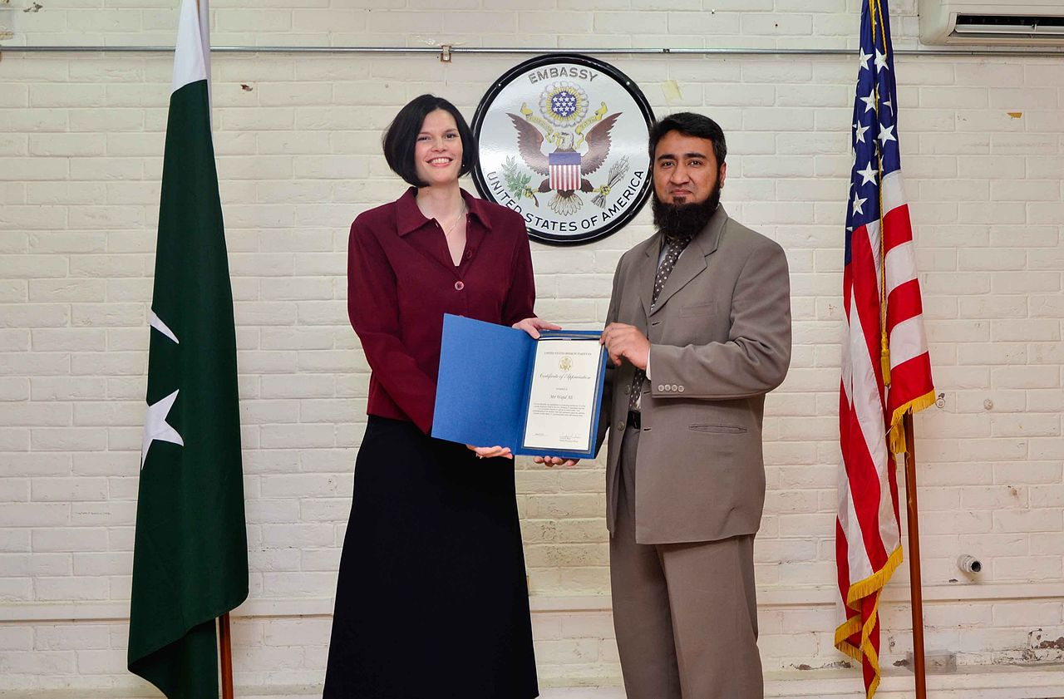
EVC Student Trends in Certificate Attainment for
2014-2015
Compared to other student groups, African American students, Native Hawaiian/Pacific Islander students, White students and students of non-categorized races are disproportionately impacted. While the overall population of students had a severely low (2%) certification rate, None, or in one case only, 1, of the impacted groups earned a certificate.

Slide 24
Certificate Completion Data from the SEP
Target Population | # of first-time students enrolled obtaining a certificate | # of students who earned a certificate within one or more years | The rate of certificate completion | Total (all student average) certificate completion rate | Comparison to the all student average ( +/- added)
American Indian/Alaskan | 8 | 1 | 0.49% | 3.57% | NA
Asian | 722 | 14 | 44.24% | 50.00% | 1.13
Black or African American | 58 | 0 | 3.55% | 0.00% | 0.00
Hispanic or Latino | 503 | 11 | 30.82% | 39.29% | 1.27
Hawaiian/Pac. Islander | 15 | 0 | 0.92% | 0.00% | 0.00
White | 142 | 1 | 8.70% | 3.57% | 0.32

Slide 25
Certificate Completion Data from the SEP, continued
Target Population | # of first-time students enrolled obtaining a certificate | # of students who earned a certificate within one or more years | The rate of certificate completion | Total (all student average) certificate completion rate | Comparison to the all student average ( +/- added)
More than one race | 142 | 0 | 8.70% | 0.00 | 0.00
Males | 782 | 15 | 47.92% | 53.57% | 1.12
Females | 822 | 13 | 50.37% | 46.42% | 0.92
Individuals with Disabilities | 57 | 2 | 3.49% | 7.14% | 2.05
Low-Income Students | 1083 | 21 | 66.36% | 75.00% | 1.13
Foster Youth/Vets | NA | NA

Slide 26

EVC Student
Trends in Transferring
2014-2015
Compared to other student groups, African American students, Hispanic students, white students, and students with disabilities are disproportionately impacted with relation to the attainment of Associates Degrees. Compared to the overall population, for whom 38% attained transferred, only 27% of African Americans, 27% of Whites, 20% of Hispanics and 4 of the 57 students with disabilities (7%) had transferred.

Slide 27
THE SEP DATA ON TRANSFER

Slide 28
Transfer Data from the SEP
Target Population | # of first-time students enrolled obtaining a degree | # of students who earned a degree within one or more years | The rate of degree completion | Total (all student average) degree completion rate | Comparison to the all student average ( +/- added)
American Indian/Alaskan | 8 | 2 | 0.49% | 0.32% | NA
Asian | 722 | 376 | 44.24% | 59.97% | 1.36%
Black or African American | 58 | 16 | 3.55% | 2.55% | -0.72%
Hispanic or Latino | 503 | 103 | 30.82% | 16.43% | -.53%
Hawaiian/Pac. Islander | 15 | 8 | 0.92% | 1.28% | 1.39%
White | 142 | 39 | 8.70% | 6.22% | -0.71%

Slide 29
Transfer Data from the SEP, cont.
Target Population | # of first-time students enrolled obtaining a degree | # of students who earned a degree within one or more years | The rate of degree completion | Total (all student average) degree completion rate | Comparison to the all student average ( +/- added)
More than one race | 0 | 0 | 0 | 0 | 0
Males | 782 | 275 | 47.92% | 43.86% | 0.92%
Females | 822 | 333 | 50.37% | 53.11% | 1.05%
Individuals with Disabilities | 5780 | 4 | 3.49% | 0.64% | -0.18%
Low-income students | 1083 | 359 | 66.36% | 57.26% | 0.86
Foster Youth/Vets | NA | NA

Slide 30
Program-Level Data for Persistence, Retention and Success
2015 | AFFIRM | ASPIRE | CAL WORKS | ENLACE | EQUITY PLUS | OASIS | YESS | DSPS | VETS
Persistence | 82% | 95% | 112% | 117% | 96% | 118% | 139% | N/A | N/A
Retention | 75% | 80% | 80% | 76% | 80% | 80% | 89% | N/A | N/A
Success | 60% | 71% | 71% | 63% | 70% | 63% | 65% | N/A | N/A
Retention % +/- from 2014 | +2% | -6% | -3% | -3% | -4% | +4% | +8% | N/A | N/A
Success % +/- from 2014 | +4% | -6% | +6% | -3% | -2% | -7% | +2% | N/A | N/A

