Slide 1

Creating a Blueprint For Student Equity and Student Success, Part 1

Slide 2
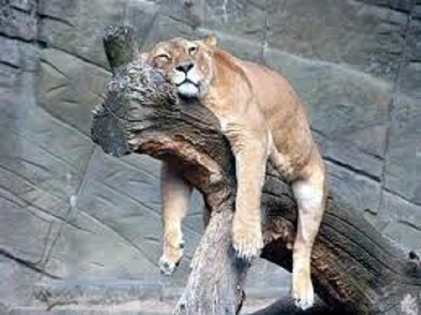
Why Are We Here?
LAZY DAYS OF SUMMER

Slide 3
Today’s Workshop Schedule: Creating a Blueprint for Equity and Student Success
Time | Activity
8:30 to 9:00 | Coffee and Goodies and an Ice Plunge
9:00 to 9:30 | An Introduction to Our Work
9:30 to 10:00 | Revisiting our Student Equity Plan
10:00 to 10:15 | A Short Break
10:15 to 12:00 | Reviewing EVC Institutional Data and Program Level Data
12:00 to 12:30 | Lunch Break
12:30 to 1:00 | Next Steps and Workshop Evaluation

Slide 4
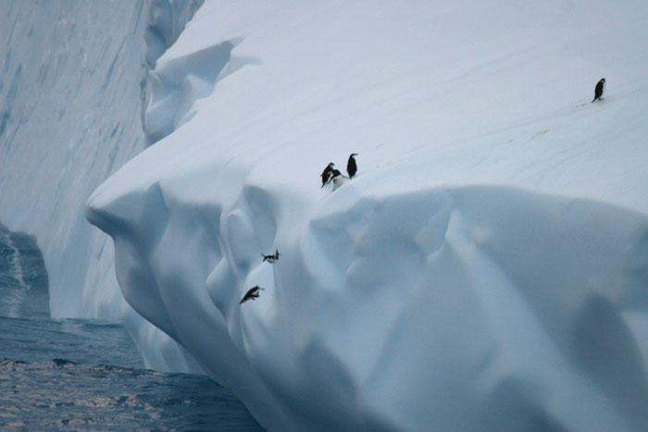
And now, an ice breaker called,
Taking the Plunge
Getting to Know You

Slide 5
Take the plunge! Please tell us…

Slide 6
An Introduction to Our Work
Creating A Blueprint for Student Equity and Success

Slide 7
WHAT IS OUR PURPOSE?
To create a Blueprint for Student Equity and Success.
To use institutional data and some program-level data to drive this process.
To share this Blueprint for Student Equity and Success with the larger campus community.

Slide 9
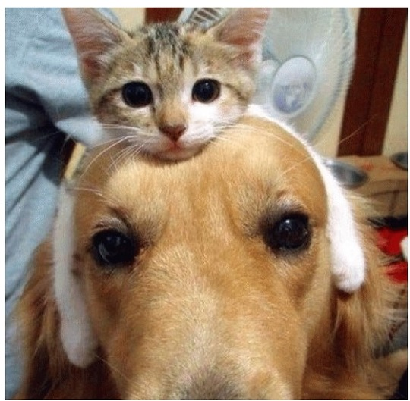
HOW WILL WE DO THIS?...
Together!

Slide 10
Revisiting our Student Equity Plan Goals
Using Them to Guide Our Blueprint for Student Equity and Success

Slide 11
Objective 1:
Designing a Small Group Strategy for Evaluating the SEP
Focus on the Evergreen Valley College Mission Statement as our Compass | Identify our Student Target Groups from the SEP Plan and Goals – These are the students that we need to pay more attention to… | Revisit Student Goals Addressed in the Student Equity Plan (SEP) | Compare Institutional Data and Some Program Level Data and Discuss How they Reflect Our Progress with the SEP
EVC’s Mission Statement is: “With Equity, opportunity and social justice, as our guiding principles, our mission is to empower and prepare students from diverse backgrounds to succeed academically and to be civically good citizens.” | Our Student Target Groups are: African American/ Blacks; Native Hawaiian/ Pacific Islander; Latinos Whites Males; Students with Disabilities Veterans | To increase the following areas by five percent (5%) within 3 years: Student Access Course Completion Basic Pathway Skills Degree and Certificate Completion Transfer Rates | These numbers and the rubric will be provided in this workshop.
June 2016

Slide 12

I HAD FORGOTTEN ABOUT THAT SEP…

Slide 13
Objective 2:
Conducting SEP Program Evaluation and Sharing Best Practices
Update Progress on Key Student Service Areas | Identify Challenging Areas and Providing Creative, Sustainable Solutions | Report Out Results to the Larger Student Services Community | Create a Sustainable Blueprint for Student Equity and Success for EVC Student Services for the Future
We will do this together today in small groups. | We will also identify these today and for the remainder of the year. | Under Dean Duarte’s leadership, this will occur at the August 26, 2016 Professional Development Day at Evergreen Valley College with a presentation by our small strategy student success group. | Dr. Calvet will work with this group to compile new data, aggregate and analyze it for reporting to the California Community College Chancellor’s Office. Our team will create a “Best Practices” Blueprint for Student Equity and Success to be used across the Evergreen Valley College campus.
June 2016

Slide 14
Objective 3:
Creating a Sustainable Blueprint for the Future of Student Services at EVC
Share Leadership and Management Skills | Use Data to Inform Decision Making and Resource Allocation | Have Program Evaluation Results Serve as a Foundation of Improvement in Student Services | Creating a Sustainable Blueprint for Student Equity and Success for EVC Student Services to Use Moving Forward
This will happen along the process of developing best practices. | We will let our data drive our decision making processes, including fund allocation. This is called strategic, data- driven, decision making. In this process, we want you to engage and reflect in a meaningful way. | Under Dean Duarte’s leadership, these results will be used to drive institutional processes now and into the future. | The work of this strategic group will inform the development of an organic and sustainable blueprint for equity and student success. The goal is for this blueprint to influence the way in which we work with students across the campus.
August of 2016 – December 2016

Slide 15
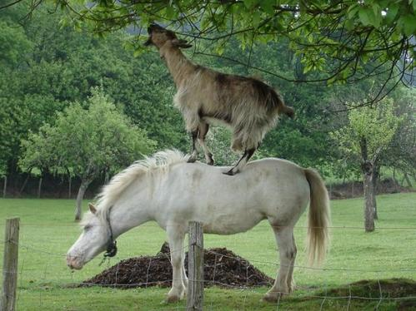
DON’T WORRY…
We will figure it out together.

Slide 16
REVISITING THE GOALS WE SET IN THE 2015 EVERGREEN VALLEY COLLEGE
STUDENT EQUITY PLAN:
To increase access by 5%, within the first three years of this plan for students who identify as White, Native Americans, and Students with Disabilities, Foster Youth and Veterans.
To increase course completion by 5% within the first three years of this plan for students who identify as Foster Youth, individuals with disabilities and Veterans.
To increase basic skills pathway completion by 5% within the first three years of this plan for students who are Latino, individuals with disabilities, males in English and African American/Black, individuals with Disabilities and Hispanic/Latino in math.
To increase degree and certificate completion by 5% within the first three years of this plan for students who are male and for those who are African American/Black, White, males, individuals with disabilities, Pacific Islanders, Foster Youth and Veterans.
To increase transfer rates by 5% within the first three years of this plan for students who are African American/Black, Latino, White, Foster Youth, Veterans and students who have a documented disability.

Slide 17
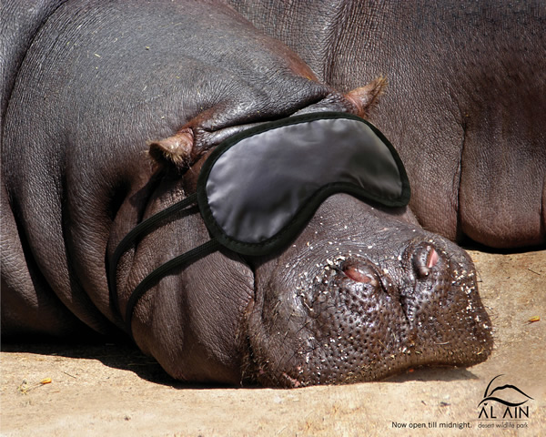
And Now, A Short Break

Slide 18
Reviewing EVC Institutional Data and Program Level Data
Looking at How our Programs Data Measures Up to SEP Goals

Slide 19

First, Let’s Review the Institutional Data Together

Slide 20
Next, Please Work Together to Answer These Three Questions…
Please pair up and consult the EVC Institutional Data (see data packet provided). Discuss the following three questions for 30 minutes, then please be prepared to report out to the larger group:
What does this data mean in relation to your program?
As an equity based program, that is receiving additional resources, how can you help the institution meet those goals?
What kind of data do you need to assess your progress in meeting those goals?

Slide 21

Now, Let’s Look at the Program-Level Data Together

Slide 22
Last, Please Pair Up and Answer this Question about Program Level Data
Please review your Program Level Data Slide in the data packet provided, discuss the question below for 15 minutes then be prepared to report out to the larger group:
1) This is the only program level data we have received so far. What else do you need to be more effective in helping the institution to meet its goals?

Slide 23
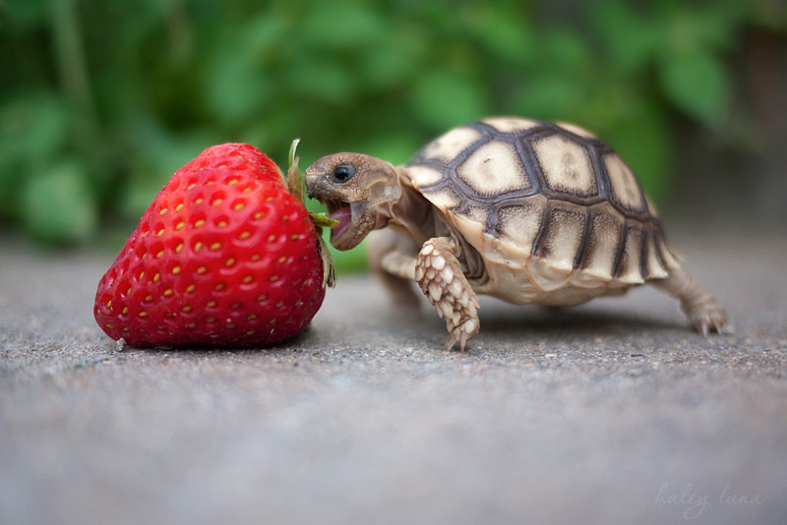
And Now, a 30-Minute Lunch Break!

Slide 24
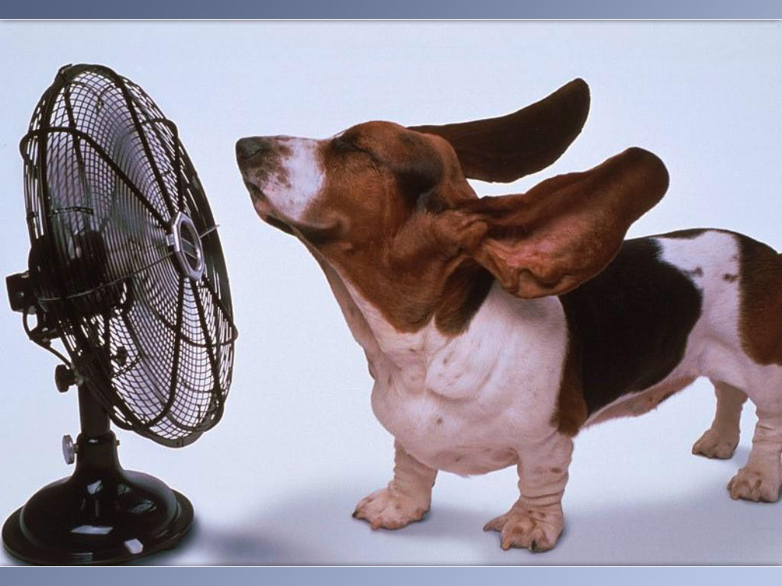
It was a breeze!
Next Steps and Workshop Evaluation
12:30-1:00

Slide 25
Next Steps:
  Your ideas from today will be made into the Blueprint for a formal presentation to be shared at Professional Development Day on August 26, 2016.
  These presentations (1-3 power point slides) will be due back to Dean Duarte and Dr. Calvet no later than June 30, 2016, to be put into a master power point.
  On July 19th, we will do the same process for the Student Support Services Plan (SSSP).
  Both of these processes will inform how we write the plan next year.
  A final power point presentation will be made and returned to you with all of the areas’ presentations no later than August 20, 2016 to confirm that all the content is correct.
  Data will be used to continually update our SEP progress going forward and our year-end report for SEP funding.

Slide 26
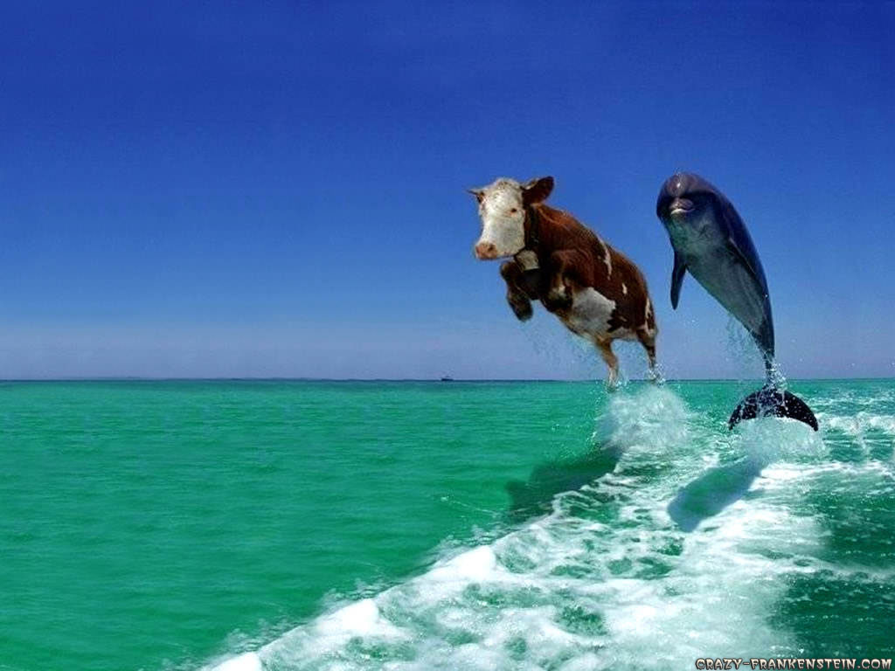
Together, We Can Do Anything! A Workshop Evaluation

Slide 27
THANK YOU!
Questions? Please reach out to:
Dr. Darla Calvet
(619) 318-0605
calvetwrites@gmail.com

