Slide 1

Creating a Blueprint For Student Equity and Student Success, Part 2

Slide 2

We Are Making Progress!
Let’s Keep It Going…

Slide 3
Lessons Learned from Our First Workshop
Creating A Blueprint for Student Equity and Success

Slide 4
Today’s Workshop Schedule: Creating a Blueprint for Equity and Student Success Part 2
Time | Activity
8:30 to 9:00 | Coffee, Goodies and Some History
9:00 to 9:30 | What We Learned from our Last Workshop
9:30 to 10:30 | Assessing Our Progress in the Five Areas of the Student Success Support Plan (SSSP) of Planning, Orientation, Placement Assessment, and Follow-Up (Group Discussion)
10:30 to 10:45 | A Short Break
10:45 to 11:30 | Review of Self-Reported Student Services Qualitative Data (Challenges and Best Practices Group Discussion)
11:30-12:00 | Lunch Break
12:00-1:00 | Activity: Creating Professional Development Day Slide Content for the 8/26/16 Campus Presentation (Group Assignment)
1:00 to 2:00 | Next Steps and Workshop Evaluation

Slide 5

What did we Learn from the Last Workshop and How Do We Use it Going Forward?
A Quick Review of Findings

Slide 6
The Top Three (3) Findings From Our First Workshop Together:
Strengthen the relationship between Student Services and the EVC Office of Institutional Research.
Improve our efforts to collect better internal data.
Engage with faculty and staff across campus to strengthen mutual efforts for student success.
*These findings were drawn from the Workshop notes and Evaluations from June, 2016.

Slide 7

Now, Let’s Revisit Our Small Planning Group Objectives…

Slide 8
Objective 1: Designing A Small Group Strategy For Evaluating the SEP and SSSP Plans
June and July, 2016
Identifying our Student Target Groups
Objective 2: Conducting SEP and SSSP Program Evaluation and Sharing Best Practices
August 26, 2016
Updating Progress on Key Student Service Areas
Objective 3: Creating a Sustainable Blueprint for the Future, September through December 2016
Sharing Leadership and Management Skills
Focusing on our Mission and Vision Statements
Comparing Institutional Data and Program Level Data against the SEP Goals
Conducting SEP and SSP Program Evaluation- How are We doing?
Reporting out to the Larger Student Services Group on August 26, 2016
Compiling Best Practices for Student Equity and Success
Using Data to Inform Decision Making and Resource Allocation in Future Reports
Using Shared Best Practices as a Blueprint for the Future
Reporting Results to the Small Group
Creating a Student Services Blueprint to present at Professional Development Day in August, 2016
Identifying Challenge Areas and Creating Solutions

Slide 9

Congratulations! You Are Making Progress
Through the Objectives.

Slide 10
Assessing Our Progress on the SSSP and its Five Student Service Areas Goals
Using Outcomes to Guide Our Blueprint for Student Equity and Success

Slide 11

WE CAN DO THIS…
YOU ARE STUDENT SUCCESS SUPER HEROES!

Slide 12
Revisiting the Plan…
What were those SSSP Areas Again?
PLANNING
ORIENTATION
ASSESSMENT FOR PLACEMENT
COUNSELING, ADVISING AND OTHER ACADEMIC SERVICES
FOLLOW-UP FOR AT-RISK STUDENTS

Slide 13

…A SSSP “CHEAT SHEET” IS NOW BEING PROVIDED TO ASSIST YOUR MEMORY.
PLEASE REMAIN CALM…

Slide 14

Facilitated Group Discussion – What Would We Like the Faculty to Know about Student Success Services to Help Our Students?

Slide 15
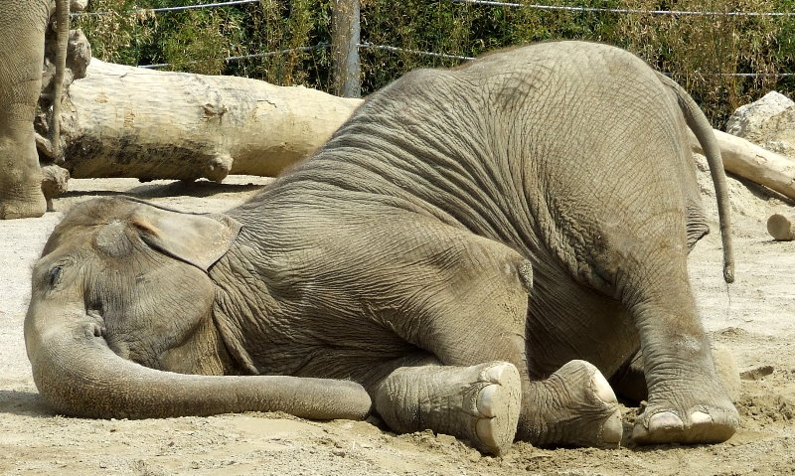
And Now, A Short Break for 15 Minutes…

Slide 16
Reviewing Our Challenges and Best Practices
Looking at How We Can Work Across Campus to Increase Student Equity and Success

Slide 17

We are now handing out a summary of your challenges and best practices provided by your emails for group discussion…

Slide 18

And Now, a 30 Minute Lunch Break!

Slide 19
Putting it All
Together:
Preparing to Promote Student Equity and Student Success within the Larger Campus Community
Looking at How We Can Share Best Practices During Staff Development to Increase Student Equity and Success

Slide 20
WHY HAVING PARTNERSHIPS WITH FACULTY
IS ESSENTIAL TO STUDENT SUCCESS
TARGETED STUDENT SUCCESS OPTIONS… +
…COMBINED WITH FACULTY EFFORTS IN THE CLASSROOM
= EQUALS BETTER STUDENT EQUITY AND SUCCESS!

Slide 21
HOW THE GEARS OF STUDENT EQUITY AND SUCCESS WORK – FOR YOU VISUAL LEARNERS!
Student Equity and Success
Faculty Efforts
Student Success Services

Slide 22
FIRST, AN EXAMPLE OF LINKING ENLACE’S STUDENT SERVICES TO THE ACCELERATED MATH PROGRAM, ALEKS
EVC STUDENT SUCCESS TEAM AT ENLACE
ALEKS MATH FACULTY (Professor Cynthia Burnham)
ENLACE approached Professor Burnham to contribute to the ALEKS accelerated math program for Latino Students.
ENLACE students are able to complete the remedial coursework during a six month program, using the summer bridge and fall semester ALEKS courses.
Professor Burnham helped design and implement the ALEKS Math Program based on research on Latino Students succeeding in accelerated programs.
Each student who enrolls in these classes has access to in and out of class tutoring and entre to the ALEKS program taught by professors such as Professor Burnham.

Slide 23

The Bottom Line: Two Way Efforts Between Student Success and Faculty Increases Student Equity!

Slide 24
Please be prepared to share your slide concept in 30 minutes. Thank you.
SMALL GROUP ACTIVITY:
Working with others from your service area, use the template provided and create a “Best Practices Slide” with the following:
  A best practice in student services that you think faculty should know about to help increase student success.
  How this information will help faculty to increase student success.
  How the faculty’s contribution will align with our student success efforts.

Slide 25
What your Finished Slide Should Look Like – Please Report Out in 30 Minutes
WRITE DOWN YOUR BEST PRACTICE IN THIS COLUMN | IN THIS COLUMN, EXPLAIN HOW KNOWING ABOUT THIS BEST PRACTICE WILL HELP FACULTY TO BETTER SERVE OUR STUDENTS. | DESCRIBE HOW THE FACULTY’S KNOWLEDGE AND USE OF THIS BEST PRACTICE WILL INCREASE STUDENT EQUITY AND SUCCESS IN THIS COLUMN.
EXAMPLE: THE ACCELERATED MATH PROGRAM FOR ENLACE STUDENTS WITH PROFESSOR BURNHAM AT EVC. | HER KNOWLEDGE AND INVOLVEMENT WITH THE ENLACE STUDENTS HELPED TO BUILD A BETTER ALEKS MATH PROGRAM. | WE NOW HAVE A HIGHER RETENTION AND SUCCESS RATE FOR ENLACE STUDENT IN ACCERATED MATH PROGRAMS AT EVC.
Now, it’s your turn in the boxes below….

Slide 26
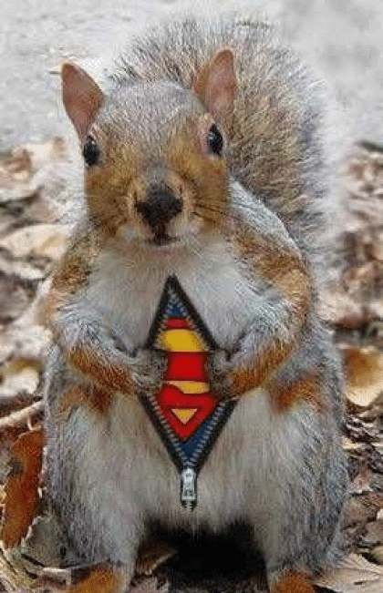
You participated and conquered!
Next Steps and Workshop Evaluation
12:30-1:00

Slide 27
Putting it All Together…
Some of your slides will be made into a “Master Presentation” for Professional Development Day on August 26, 2016.
If your slide is included, you will be presenting at the PDD Workshop.
Your new information will be included in program review and program planning going forward.

Slide 28

We Did It. Way to Go, Student Success Team!

Slide 29
THANK YOU!
Questions? Please reach out to:
Dr. Darla Calvet
(619) 318-0605
calvetwrites@gmail.com

