Slide 1
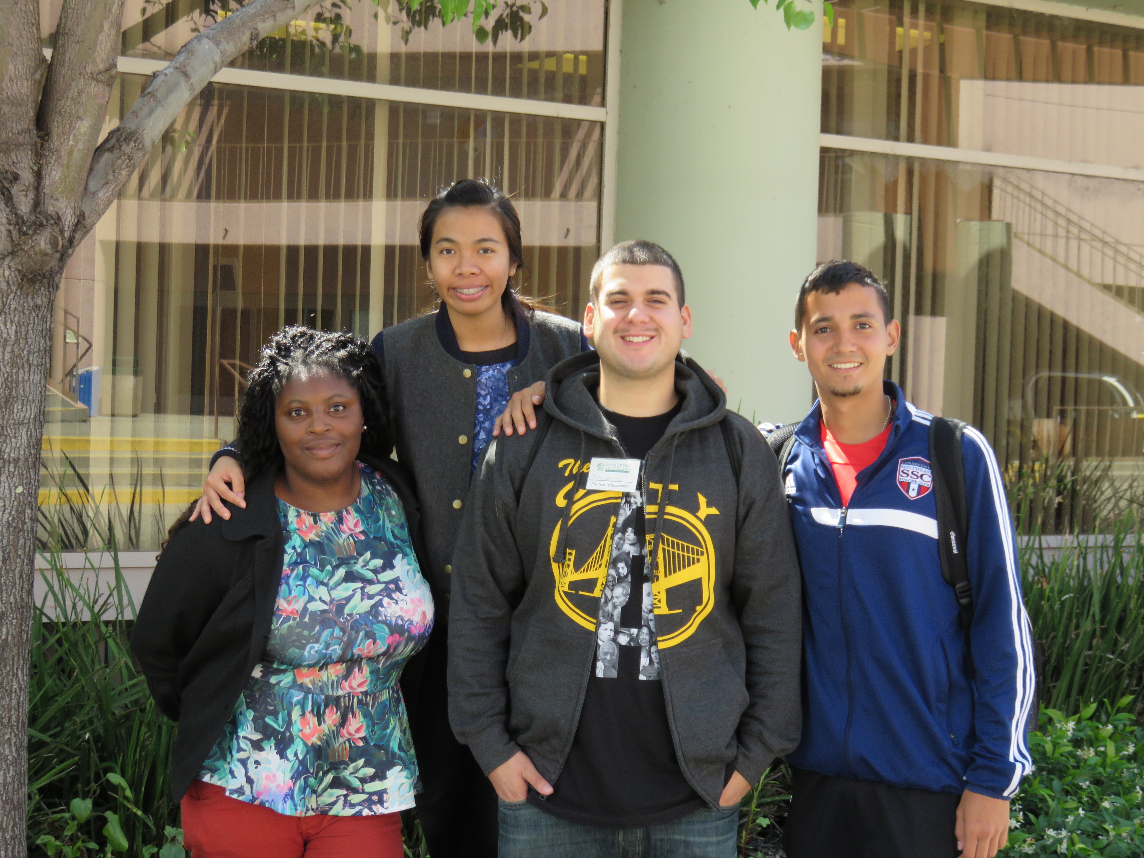

Student Equity
Student Success Support Plan
Accreditation
Student Success
Student Equity Plan
Board of Trustees Presentation
Tuesday, October 4, 2016

Slide 2
Summary of Data
Main Sources of Data cited in Standard 2C
  Student Success Support Program (SSSP)
    Student Success Act of 2016 ((SB1456) Mandates Core Services
      Orientation, Assessment, Educational Planning, Student Intervention & Transfer/Career Services
  Student Equity Plan
    Institutional Data demonstrating equity gaps in student performance
      Equity Goals
      Activities to achieve those goals

Slide 3
SSSP Data
Data Mart Data Information
SSSP Services Increasing Capacity from 14-15 and 15-16
 |  |  | Summer | Fall | Spring | Total | Change +/- | %
Orientation | 2014-15 |  | 531 | 988 | 432 | 1951
 | 2015-16 |  | 757 | 734 | 1044 | 2535 | 584 | 30%
Assessment | 2014-15 |  | 1123 | 1139 | 2283 | 4545
 | 2015-16 |  | 1320 | 1056 | 2190 | 4566 | 21 | -1%
Ed Planning | 2014-15 |  | 1239 | 2169 | 2379 | 5787
 | 2015-16 |  | 1441 | 2893 | 3228 | 7562 | 1775 | 31%
Advisement | 2014-15 |  | 1324 | 3242 | 3471 | 8037
 | 2015-16 |  | 1221 | 3157 | 3583 | 7961 | -76 | 1%
Follow-up | 2014-15 |  | 22 | 125 | 184 | 331
 | 2015-16 |  | 24 | 107 | 199 | 330 | -1 | -1%
Other | 2014-15 |  | 633 | 801 | 2023 | 3457
 | 2015-16 |  | 793 | 2760 | 3213 | 6766 | 3309 | 96%
 | 2014-15 Total |  |  |  |  | 24108
 | 2015-16 Total |  |  |  |  | 29720
 | Increased Capacity |  |  |  |  | 5612

Slide 4
Core Service Updates
Orientation – Contract with Fervian Productions LLC, Development of Innovative On-line Orientation in progress
Assessment – Task Force working on implementation of CCCAsses (Common Assessment), Adding HS GPA in student placement as highest predictor of student performance.
Educational Planning – Providing more counseling time for educational plans; signed contract for implementation of Cranium Café (online counseling),
Student Follow-up/Intervention – Faculty Participation in Early Alert has grown from 50 to 90 Instructors, Systematic and Coordinated follow-up services are provided to Probation Dismissal Students. Program Specialist will be a liaison to FA for follow-up of students losing BOG Fee Waiver
Transfer/Career Services – Filling Transfer Counselor vacancy; establishing Graduation Facilitator/Evaluator position to assist in student program completion.

Slide 5
Other SSSP Initiatives and Activities
SARS Anywhere – provides online scheduling access to orientation, assessment and counseling, sends email, phone and text reminders of appointments
GradGuru – a retention college application that provides timely reminders and information to students based on their status: prospective, new and continuing
Establishing Student Services CTSS Analyst position
Student Events
  Days at the Green (for early admission HS graduates)
  Summer Picnic (to introduce summer students to Evergreen Community)
  Transfer and Career Workshops
  Transfer Day
  Probation/Dismissal Workshops
  Next Steps to Success (for continuing students to plan for their registration date)

Slide 6
Student Equity Plan
Institutional Data that identifies student performance gaps in following areas:
  Access
  Course Completion
  Basic Skills/ESL
  Degree and Certificate Completion
  Transfer

Slide 7
Student Equity Goals
Goal | Timeline | Target Population
Increase access by 5% | Spring 16-Spring 2020 | Native Americans, White, Students with Disabilities (Low income/Foster Youth not tracked)
Increase course completion by 5% | Spring 16-Spring 2020 | Foster Youth, Students with Disabilities (Low income not tracked)
Increase basic skills pathway by 5% | Spring 16-Spring 2020 | Basic Skills/ English Students with Disabilities (Foster Youth, Low-income, Veterans not tracked) | Basic Skills/ESL Hispanic/Latino, Students with Disabilities (Foster Youth, Veterans not tracked) | Basic Skills/Math Black or African American, Students with Disabilities (Low income, Veterans not tracked)
Increase degree completion by 5% | Spring 16-Spring 2020 | Students with Disabilities, White, Male (Foster Youth, Low income and Veterans not tracked)
Increase certificate completion by 5% | Spring 16-Spring 2020 | Black or African American, Native Hawaiian or other Pacific Islander (Foster Youth, Students with Disabilities, and Veterans not tracked)
Increase transfer rates by 5% | Spring16-Spring 2020 | Black or African American, Hispanic/Latino, White, Students with Disabilities (Foster Youth and Veterans not tracked)

Slide 8
Student Equity Action Plans and Activities
Access – Hiring of Outreach Counselor, developing recruitment plan, marketing, more visible in social media, strengthened relations with High Schools
Course Completion – Library text program, Will use HS GPA for placement, Early Alert, Tutoring, Book Voucher/Rental Options, Probation/Dismissal Intervention Services. Specialized counseling for Veterans, CalWORKS, EOPS, DSPS, Foster Youth, OASISS (AB540), Equity Plus Program
Basic Skills/ESL – embedded tutoring, enhanced placement, focused support by Special Programs, folding in BSI into Student Success Advisory Committee.
Certificate and Degree Completion – Establishing Graduation Facilitator/Evaluator position to increase program completion, building our Degree Audit Program.
Transfer - Establishing Graduation Facilitator/Evaluator position to increase program completion, New Articulation Officer, New Transfer Counselor added to increase capacity

Slide 9
Student Equity Update – Cont’d
Initiating Equity Mindedness Culture
  Professional development
    2 Team Workshops and PDD Workshop for the College
    District Wide PDD on Equity
Building Capacity
  Hired: Veterans Counselor, Equity/Foster Youth Counselor, CalWORKS Counselor, Veterans Community Engagement Specialist, DSPS Assistive Services Specialist, Program Specialist (Student Success/Financial Aid Liaison).

Slide 10
Student Equity 2015-16 Strategy
Laying the infrastructure
  Built a coalition of all student equity programs
  Directed equity resources to strengthen these programs
    AFFIRM- supports African American Students
    ASPIRE – supports Asian/Pacific Islander Student
    CalWORKS – supports students in CalWORKS Program
    DSPS – supports students with Disabilities
    ENLACE – supports Hispanic/Latino Students
    EOPS – supports economically and educationally disadvantaged students
    EQUITY PLUS – supports first generation, at-risk students
    OASISS – supports AB540 students
    VETERANS – supports Veteran students
    YESS – supports Current or former Foster Youth students

Slide 11
Next Steps
Future Strategic Planning (Integration of SSSP, SE and BSI)
Identify Service and Reporting Gaps in current infrastructure
Strengthen the partnership between Student Services and Academic Affairs
Increase Collaboration and Coordination efforts among Student Services
Continue to Increase Capacity
Promote equity mindedness through college-wide professional development

