Slide 1

Anxiety Toolbox
Adapted from the University of California, Santa Cruz Counseling and Psychological Services Anxiety Toolbox Series

Slide 2

Follow Along in the Student Workbook!
The workbook can be found on the EVC website:
https://www.evc.edu/wellness

Slide 3

Anxiety Toolbox - Session One
Welcome
Participation
Overview of Anxiety Toolbox
Today’s agenda:
  Anxiety vs. Stress
  How anxiety effects the body
  Symptoms of anxiety interact and how they interact
  A simple tool to manage anxiety

Slide 4
What is the difference between stress and anxiety?

Slide 5
Stress vs. Anxiety
Stress or Everyday Anxiety
  It’s a response to a known environmental factor (or stressor)
  Symptoms usually go away when the stressor goes away
  It’s something we all experience at some point in our lives
  It can be motivational
Sometimes a stressor can be ongoing, chronic, or overwhelming, and can lead to clinical anxiety.

Slide 6
Stress vs. Anxiety (1)
Clinical Anxiety
  It can occur with chronic stress, a major stressful event, or when there is no identifiable stressor
  Symptoms persist even after the stressor has passed
  Symptom intensity is exaggerated compared with what one would expect in a particular situation
  It causes significant distress and interferes with your daily life
  It is generally not motivational
  It is perpetuated by avoidance (which we will discuss later)
  Anxiety can take many different forms and may or may not be diagnosable

Slide 7
Adapted from: http://www.adaa.org/understanding-anxiety

Slide 8
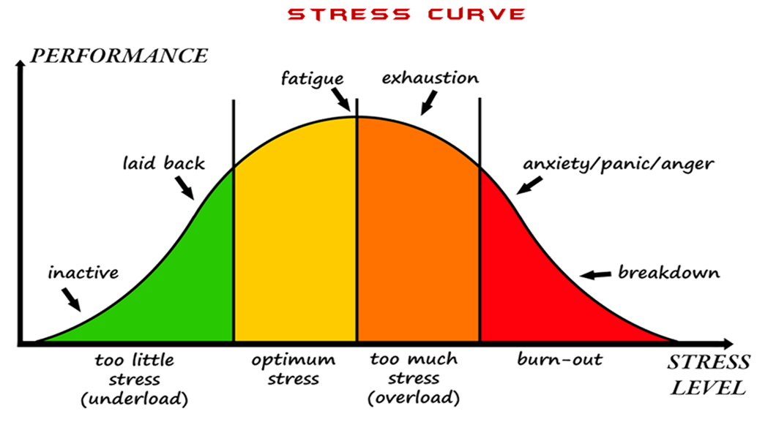
https://www.pinclipart.com/pindetail/iTJboRb_pictures-of-stress-stress-levels-clipart/

Slide 9
What happens when we avoid situations that trigger anxiety?

Slide 10
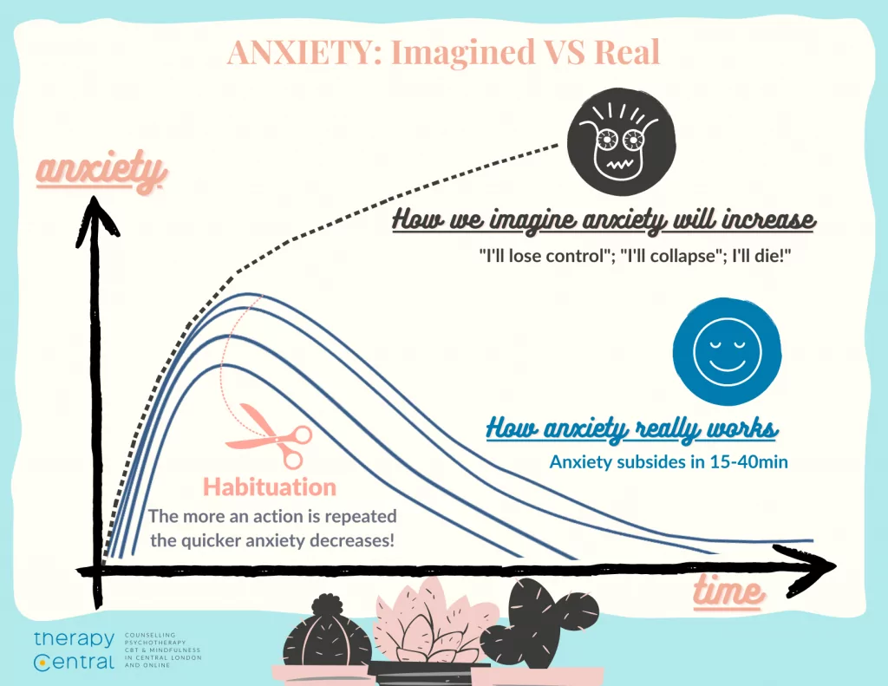
Anxiety - Avoidance Roller Coaster
https://therapy-central.com/2021/02/19/cbt-for-anxiety/

Slide 11
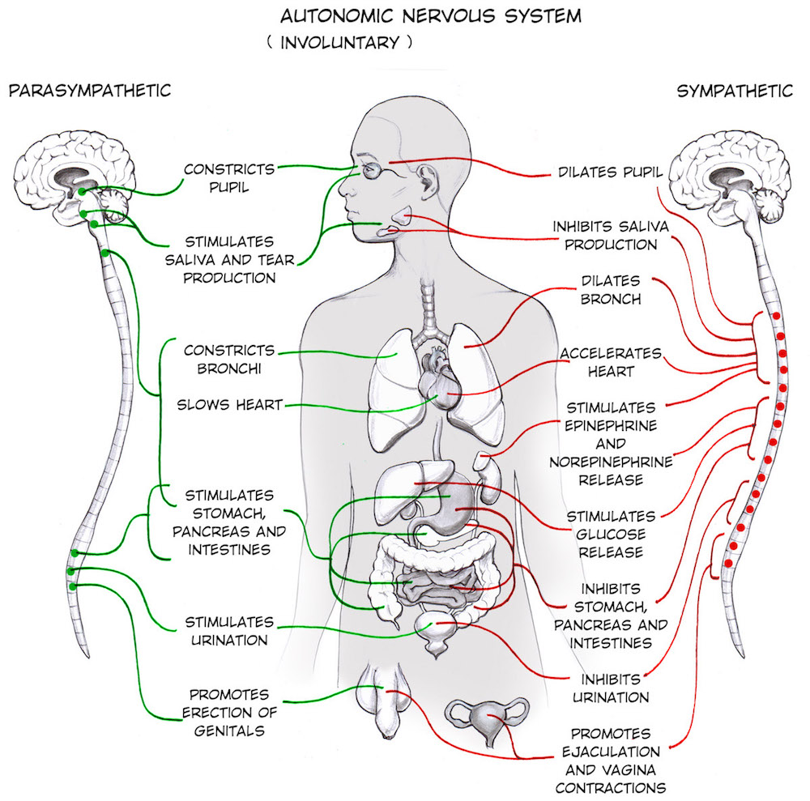
Threat System (Fight or Flight)
The ‘fight or flight’ response gets the body ready to fight or run away. Once a threat is detected, your body responds automatically. All of the changes happen for good reasons, but may be experienced as uncomfortable when they happen in ‘safe’ situations.
https://backyardbrains.com/experiments/Sympathetic_Nervous_System

Slide 12
Which physical symptoms of anxiety and stress have you experienced?

Slide 13
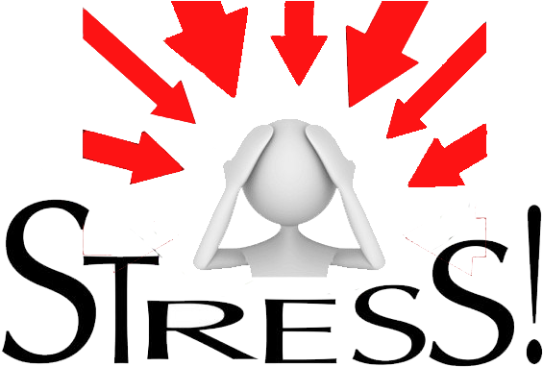
Common Anxiety Symptoms
Physical Symptoms
o Increased heart rate
o Shortness of breath
o Chest pain or pressure
o Choking sensation
o Dizziness, lightheadedness
o Sweating, hot flashes, chills
o Nausea, upset stomach, diarrhea
o Trembling, shaking
o Weakness, unsteadiness, faintness
o Tense muscles, rigidity
o Dry mouth
o Other: ________________________
https://www.pinclipart.com/maxpin/xiohJ/

Slide 14
Common Anxiety Symptoms
Behavioral Symptoms
Restlessness, feeling keyed up, feeling on edge
Being easily fatigued
Muscle tension
Sleep Disturbance
  Difficulty falling or staying asleep
  Restless, unsatisfying sleep
Cognitive Symptoms
Difficulty Concentrating or mind going blank
Emotional Symptoms
Excessive anxiety/worry
Fear/anxiety in social situations
Panic Attacks (can occur)
  Palpitations, pounding heart, accelerated heart rate
  Sweating
  Trembling/shaking
  Sensations of shortness of breath or smothering
  Feeling of choking
  Chest pain/discomfort
  Nausea/abdominal distress
  Feeling dizzy/unsteady/lightheaded/faint
  Chills/heat sensations
  Paresthesia's (numbness/tingling)
  Derealization (feelings of unreality) or Depersonalization (detachment from oneself)
  Fear of losing control or “going crazy”
  Fear of dying
American Psychiatric Association. (2022). The diagnostic and statistical manual DSM-5TR.

Slide 15
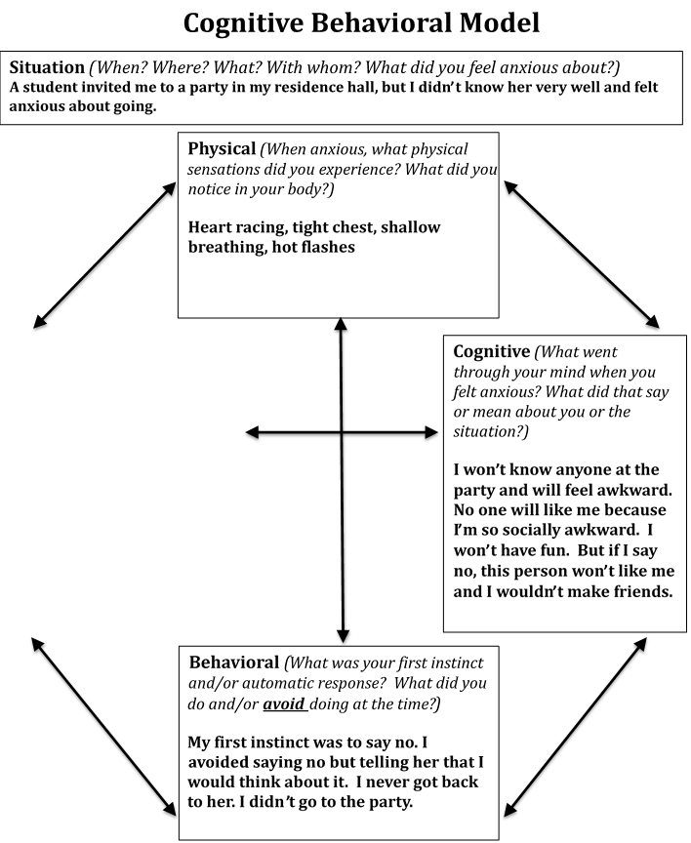
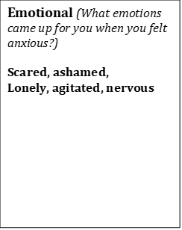
The Cognitive Behavioral Model helps us understand how physical, emotional, cognitive and behavioral symptoms of anxiety interact with and impact each other.
Accessibility Checker in PowerPoint

Slide 16
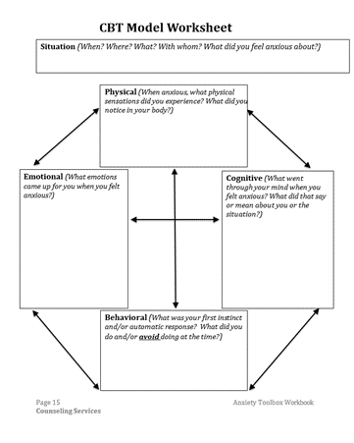
CBT Model Worksheet
Think of a situation when you felt anxious:
  What physical sensations did you experience?
  What emotions came up for you?
  What went through your mind?
  What did you interpret the situation to mean?
  What was your automatic or instinctive response?
  What did you do at the time?
  What did you avoid doing at the time?

Slide 17
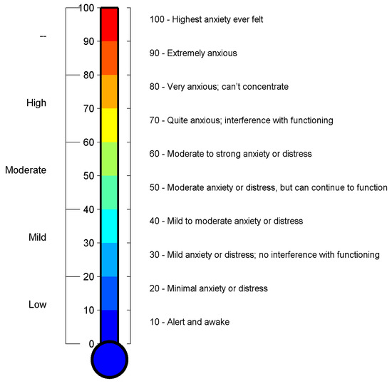
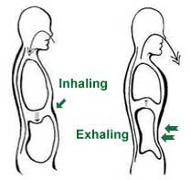
Diaphragmatic Breathing
1. Rate your anxiety using the Subjective Units of Distress Scale (SUDS)
2. Practice breathing using the diaphragm
3. Re-rate your anxiety using the Subjective Units of Distress Scale (SUDS)
Šalkevicius, J., Damaševičius, R., Maskeliunas, R., & Laukienė, I. (2019). Anxiety level recognition for virtual reality therapy system using physiological signals. Electronics, 8(9), 1039.
https://www.mdpi.com/2079-9292/8/9/1039

Slide 18
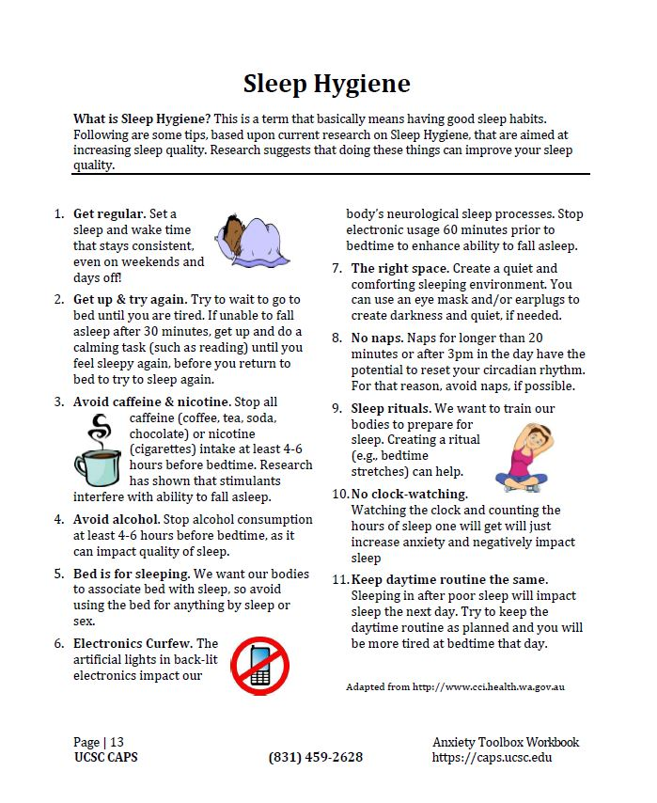
Sleep Hygiene
Are anxiety and stress affecting your ability to sleep? Using one or more of these sleep strategies can help.
Which sleep hygiene tip would you like to try this week?

Slide 19

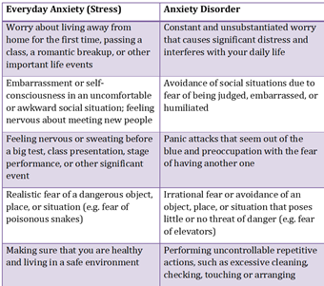
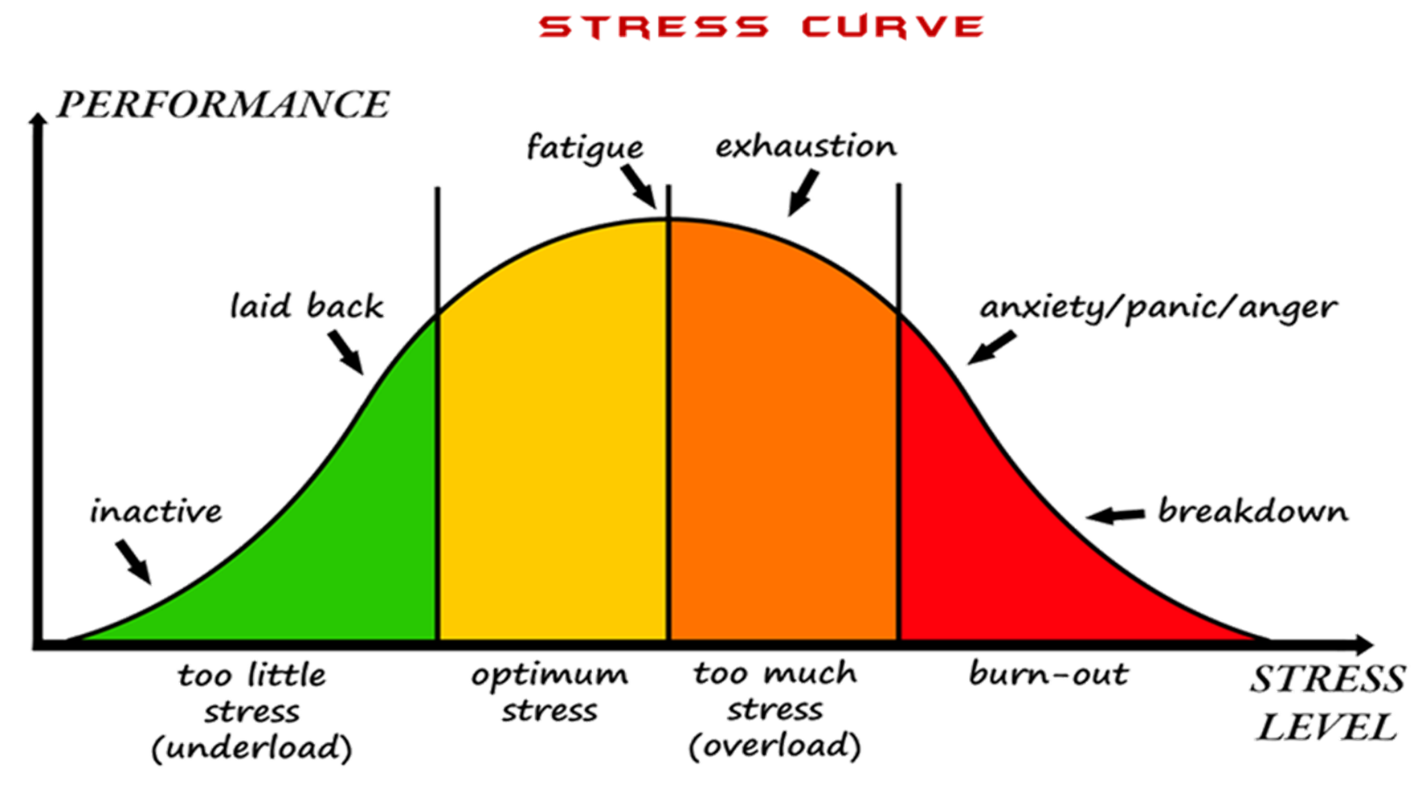
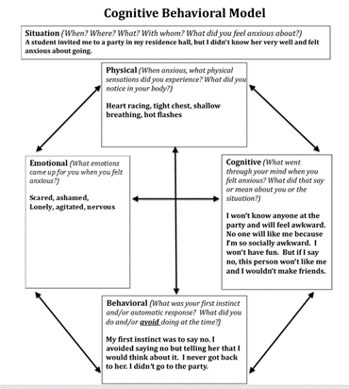

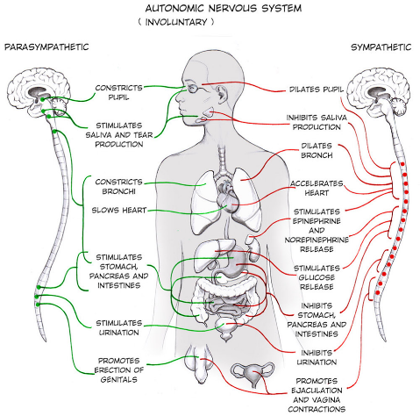

Anxiety Toolbox - Session One Summary
Stress v. Anxiety
Avoidance of Anxiety
Stress and Performance
Physical Responses
CBT Model
Anxiety Rating
Diaphragmatic Breathing

Slide 20
Anxiety Toolbox - Session One Homework
  Homework 1: Complete at least one CBT Model worksheet for review next week
  (see p. 15 for blank copies)
Homework 2: Practice diaphragmatic breathing
Homework 3: Implement one sleep hygiene tip
Next week: How to identify and manage anxious thoughts. See you then!

