Slide 1

Anxiety Toolbox
Adapted from the University of California, Santa Cruz Counseling and Psychological Services Anxiety Toolbox Series

Slide 2

Follow Along in the Student Workbook!
The workbook can be found on the EVC website:
https://www.evc.edu/wellness

Slide 3

Anxiety Toolbox - Session Two
Welcome back!
Participation
Overview of Anxiety Toolbox
Today’s agenda:
  Review CBT model and homework
  Discover how thoughts effect anxiety
  Identify thinking styles that may trigger anxiety
  Discuss how to begin to make changes in thought patterns

Slide 4
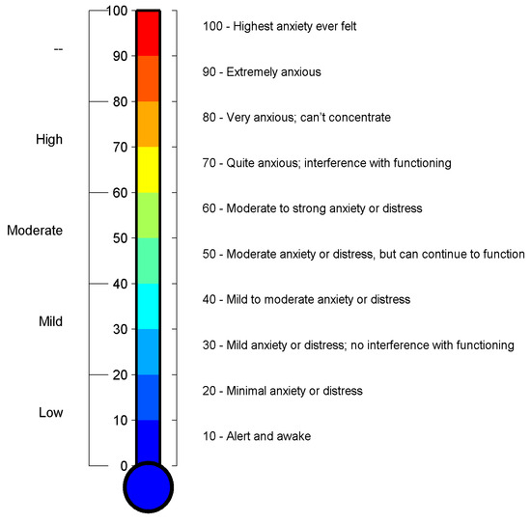
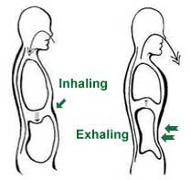
Diaphragmatic Breathing
1. Rate your anxiety using the Subjective Units of Distress Scale (SUDS)
2. Practice breathing using the diaphragm
3. Re-rate your anxiety using the Subjective Units of Distress Scale (SUDS)
Šalkevicius, J., Damaševičius, R., Maskeliunas, R., & Laukienė, I. (2019). Anxiety level recognition for virtual reality therapy system using physiological signals. Electronics, 8(9), 1039.

Slide 5
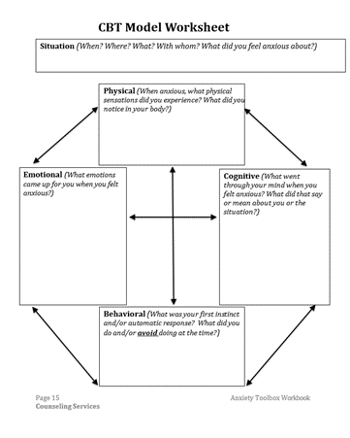
CBT Model Worksheet
Think of a situation when you felt anxious:
  What physical sensations did you experience?
  What emotions came up for you?
  What went through your mind?
  What did you interpret the situation to mean?
  What was your automatic or instinctive response?
  What did you do at the time?
  What did you avoid doing at the time?

Slide 6
Automatic Thoughts
  Automatic thoughts are not intentional, they simply pop into our heads
  Automatic thoughts can be helpful or unhelpful:
    Distracting thoughts when you are studying that you need to talk to a friend
    Anxiety provoking thoughts when you’re having a conversation that make you self conscious
    Interpretation of physical symptoms as being dangerous:
      - “My heart is racing – something must be wrong with me”
      - “My hands are shaking – everyone will notice I’m nervous”
  Some automatic thoughts are in response to an external stimulus:
    You greet someone while walking on campus and they don’t respond
    You ask a friend to meet up with you and they decline
    You get an unexpectedly low score on an exam or assignment

Slide 7
How do our thoughts impact our emotions?

Slide 8
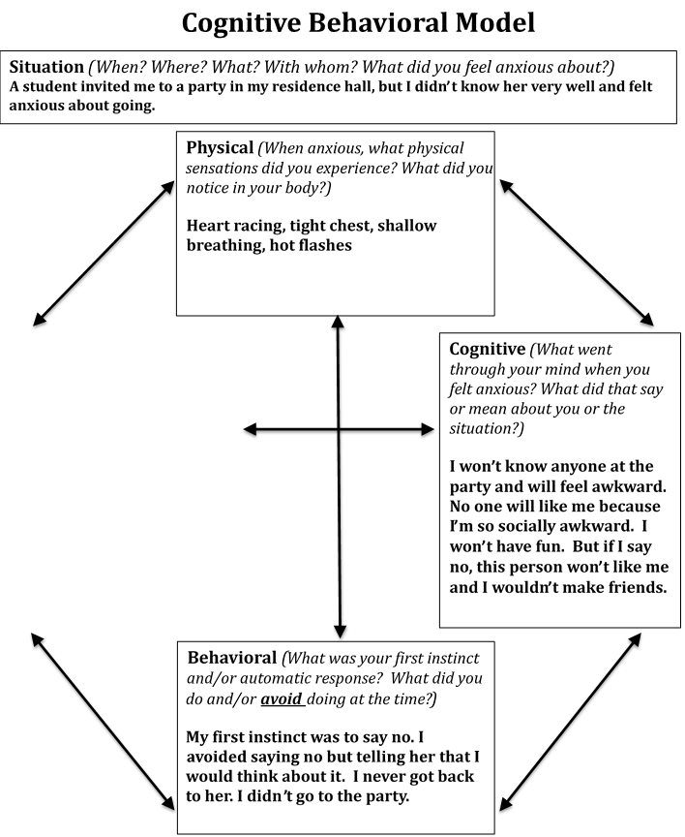
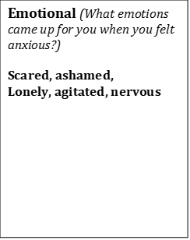

CBT Model Worksheet
How would the thought, “No one will like me because I’m so socially awkward” affect the way you feel?

Slide 9

Cognitive Distortions
Patterns of Unhelpful Thinking
All-or-Nothing / Black and White Thinking
Mental Filter / Selective Evidence
Jumping to Conclusions / Mind Reading
Overgeneralization
Disqualifying the positive
Magnification (Catastrophizing) and Minimization
Rigid Thinking
Emotional Reasoning
Labeling and Mislabeling
Personalization
Images from: https://clipart-library.com/

Slide 10



Cognitive Distortions – Patterns of Unhelpful Thinking
All-or-Nothing / Black and White Thinking:
  Seeing things in extremes, not seeing the grey areas
  Ex: “If I’m not perfect I have failed”
Mental Filter / Selective Evidence:
  Only noticing things that confirm what we already believe
  Can foster optimism and pessimism about the world
Jumping to Conclusions / Mind Reading:
  Inaccurate belief that we know what others are thinking/feeling
  Ex: “My friend is frowning, that means they hate me”
Images from: https://clipart-library.com/

Slide 11
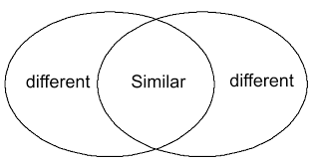



Cognitive Distortions – Patterns of Unhelpful Thinking
Overgeneralization:
  Drawing broad conclusions from a single event
  Ex: “I got a bad grade on an exam, so I am stupid and a failure”
Disqualifying the positive:
  Discounting the good things that have happened for some reason
  Ex: “My boss said I did a good job, but they were just being nice”
Magnification (Catastrophizing) and Minimization:
  Blowing things out of proportion or inappropriately minimizing their importance
Images from: https://clipart-library.com/

Slide 12



Cognitive Distortions – Patterns of Unhelpful Thinking
Rigid Thinking:
  Using critical words like ‘should’ or ‘must’, resulting in feelings of guilt and shame, resentment and anger
Emotional Reasoning:
  Taking feelings as facts
  “I feel it, so it must be true”
Labeling and Mislabeling:
  Assigning value to ourselves and others based on one instance/experience
Personalization:
  Blaming oneself or taking things personally, without logical reason
Images from: https://clipart-library.com/

Slide 13
CBT Model Worksheet
What type of cognitive distortions do you find in this example?
What patterns of unhelpful cognitions do you recognize in your own thinking?

Slide 14


Identifying Cognitive Distortions
“I won’t know anyone at the party and will feel awkward”
“No one will like me because I’m so socially awkward”
“I won’t have fun”
“If I say no, this person won’t like me and I won’t make friends”
Images from: https://clipart-library.com/

Slide 15
Identifying Triggers for Automatic Thoughts
Triggers can be internal events such as a physical sensation or emotion
Triggers can be external events such as a test or social interaction
Responses to Internal Stimuli:
Emotions
  Feeling down, fear or worry
Mental Images
  Replaying interpersonal interactions or performance experiences
Physical State
  Racing heartbeat, lightheadedness, tight chest
Thoughts
  “I might fail this test”, “That person must not like me”, “If someone talks to me in class I won’t be able to handle it”
Responses to External Stimuli:
Presence of Others
  Attending a social event, meeting with a professor, interactions with roommates or family
Physical Setting
  Classroom, open areas on campus, inside a car
Social Pressure
  Feeling pressure to make friends, to perform well in school, to conform
Activities
  Sports event, party, going home for the weekend

Slide 16
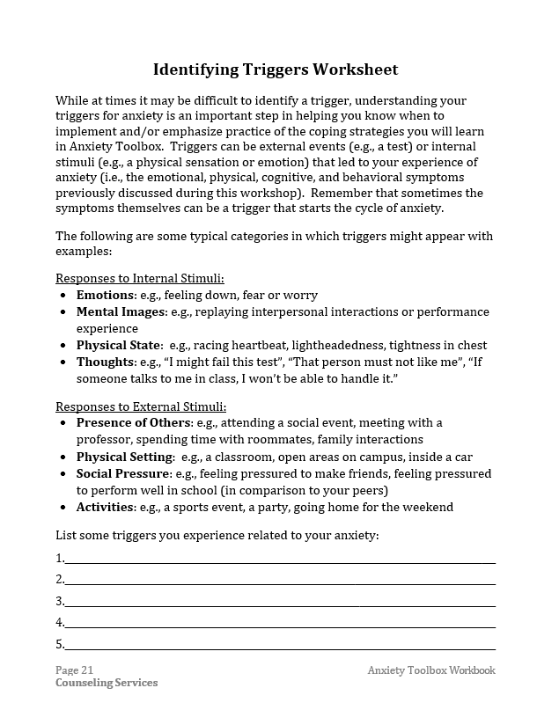
Identifying Triggers Worksheet

Slide 17


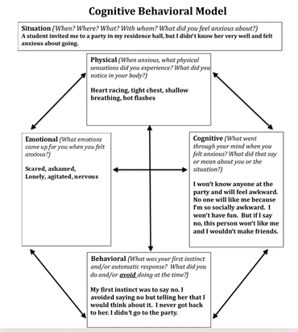
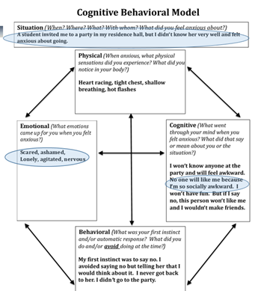
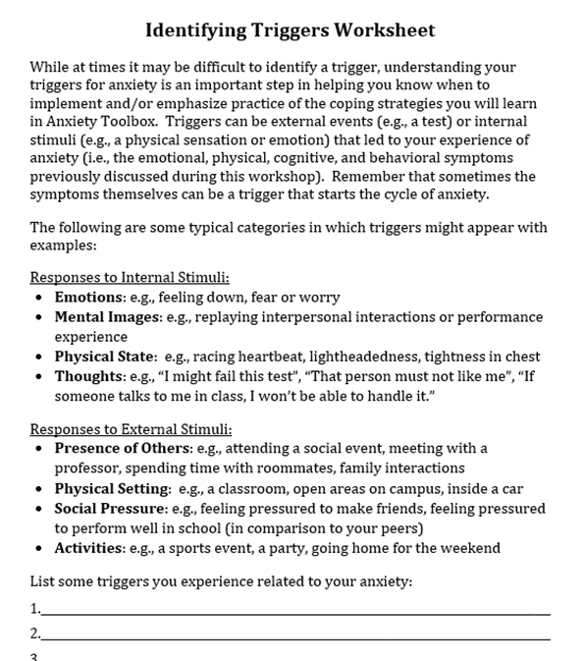
Anxiety Toolbox - Session Two Summary
Anxiety Rating
CBT Model
Diaphragmatic Breathing
Cognitive Distortions
Thoughts and Emotions
Identifying Triggers
Images from: https://clipart-library.com/

Slide 18

Progressive Muscle Relaxation
Reduces stress in the body when you systematically tense and relax each muscle group
Allows for release of tension to promote relaxation, which is counter to feelings of anxiety
Helps you recognize and identify feelings of tension and provides a tool to help you relax
Image from: https://clipart-library.com/

Slide 19

Other Mindfulness Resources
See “Online Resources” and “Apps” on P.44 in your Workbook!
Image from: https://clipart-library.com/

Slide 20
Anxiety Toolbox - Session Two Homework
  Homework 1: Identifying Triggers Worksheet
  Homework 2: Complete at least one CBT Model worksheet for review next session
  (see p. 25 for blank copies)
Homework 3: Practice diaphragmatic breathing or progressive muscle relaxation
Next session: Grounding techniques and new ways to address automatic thoughts. See you then!

