Slide 1


Anxiety Toolbox
Adapted from the University of California, Santa Cruz Counseling and Psychological Services Anxiety Toolbox Series

Slide 2

Follow Along in the Student Workbook!
The workbook can be found on the EVC website:
https://www.evc.edu/wellness

Slide 3
Anxiety Toolbox - Session Three
Welcome back!
Participation
Review of Sessions 1 and 2
Today’s agenda:
  Review CBT model and homework
  Discuss the Alternative Response Model
  Identify grounding techniques that can help decrease anxiety
  Develop a personalized action plan

Slide 4
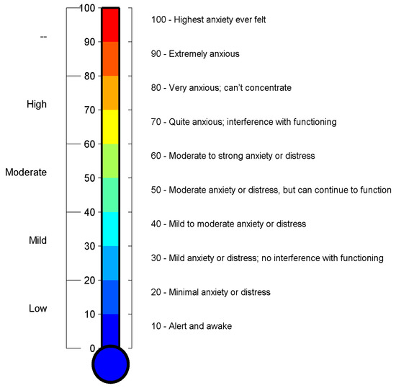
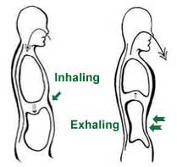
2. Practice breathing using the diaphragm
Diaphragmatic Breathing
1. Rate your anxiety using the Subjective Units of Distress Scale (SUDS)
3. Re-rate your anxiety using the Subjective Units of Distress Scale (SUDS)
Šalkevicius, J., Damaševičius, R., Maskeliunas, R., & Laukienė, I. (2019). Anxiety level recognition for virtual reality therapy system using physiological signals. Electronics, 8(9), 1039.

Slide 5
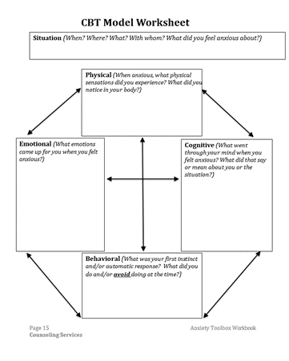
CBT Model Worksheet
What were your reactions when you felt anxious?
  What physical sensations did you experience?
  What emotions came up for you?
  What went through your mind?
  What did you interpret the situation to mean?
  What was your automatic or instinctive response?
  What did you do at the time?
  What did you avoid doing at the time?
Cognitive restructuring focuses on identifying and changing the way you think about or interpret situations so you can decrease anxiety.

Slide 6
How do we change the way we think in a way that will decrease anxiety?

Slide 7
Cognitive Restructuring
  Taking a different approach to thinking about the anxiety provoking situation:
    Purposefully slowing down and taking the time to self observe
    Challenging automatic and unhelpful thinking patterns
    Developing a broader perspective on the situation
  Cognitive restructuring takes time and practice:
    When you notice anxiety, stop and take a step back before you react
    Take the time to pay attention to what is going on in your mind and body
    Be intentional about what happens next:
      Use breathing to address your body’s physiological response
      Identify the unhelpful thoughts that may be triggering or contributing to your anxiety
      Develop an alternative response that allows you to change perspective on the situation

Slide 8
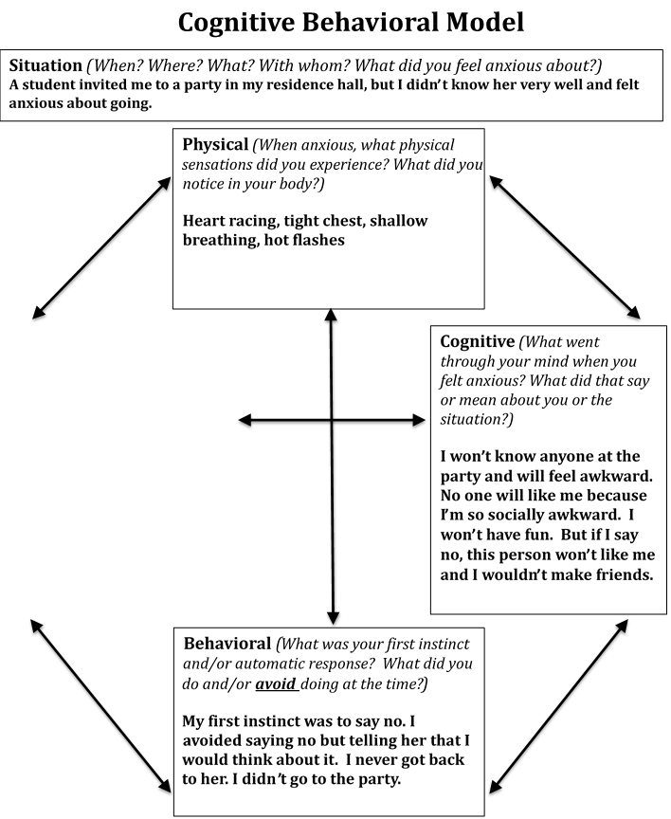
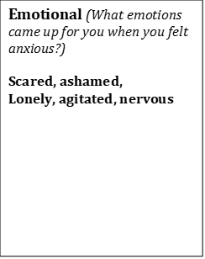
CBT Model Worksheet (1)
Automatic thought (leads to distress):
“No one will like me because I’m so socially awkward”
Thinking Positively (black and white thinking):
“It’s going to be great!”
Alternative response (realistic and believable):
“I might not be as socially awkward as I think”
“If she invited me she must want me there”
“I might have an okay time even if I’m anxious”

Slide 9
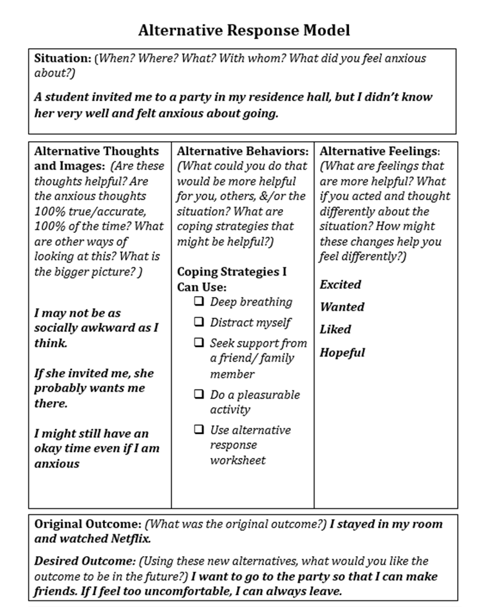
Alternative Response Model Worksheet
Changing perspective requires challenging your automatic thoughts:
  Are these thoughts helpful?
  Are the anxious thoughts 100% true 100% of the time?
  What are other ways of looking at this?
  What is the bigger picture?
What alternative behaviors could be helpful?
How might your feelings change?
What would you like the desired outcome to be in the future?

Slide 10


Cognitive Distortions and Alternative Thoughts
If you’re having trouble, you can try asking yourself some of the questions on pages 29 & 30:
-What is the evidence my thoughts are true?
-Am I exaggerating how bad the result might be?
-Can I really predict the future or read minds?
-If a friend were in this situation and had this thought, what would I say to them?
Images from: https://clipart-library.com/

Slide 11
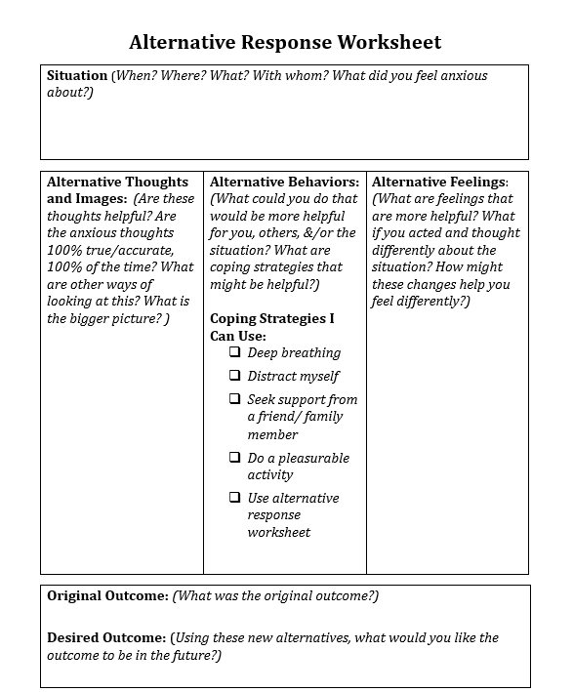
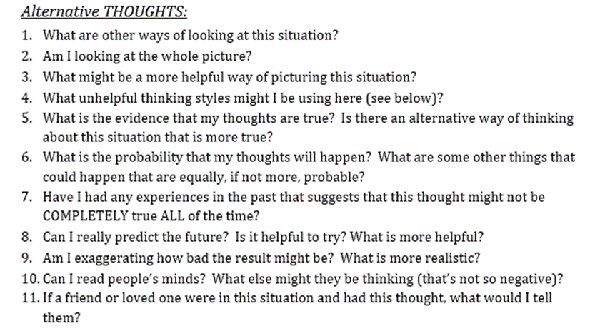
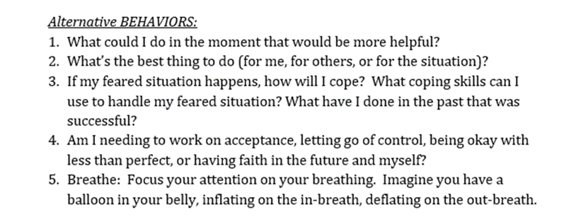
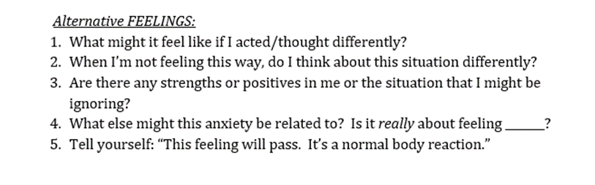
Alternative Response Worksheet

Slide 12
5-4-3-2-1 Grounding / 5 Senses Grounding
5
Grounding techniques allow you to re-center by pausing, re-focusing, getting unstuck, and coming back to the moment
Helpful for people who experience anxiety as physical/sensory symptoms such as depersonalization and derealization
See p. 40-42 for ideas or consider some of the activities on p. 34
One helpful grounding technique is “5-4-3-2-1”
  Observe 5 things you can see
  Observe 4 things you can feel
  Observe 3 things you can hear
  Observe 2 things you can smell
  Observe 1 good thing about yourself
4
3
2
1

Slide 13
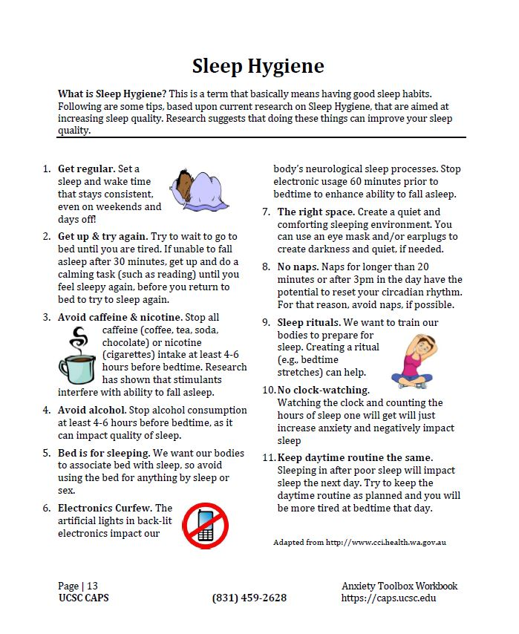
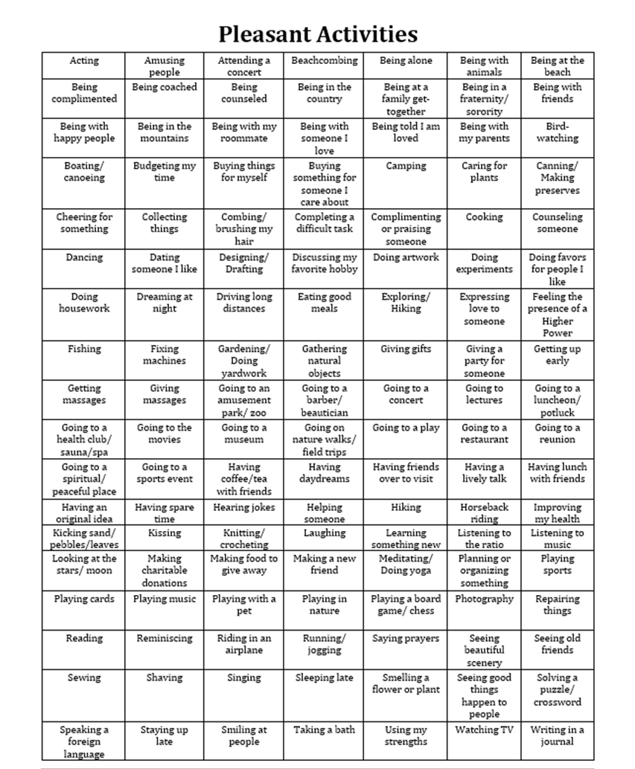
Additional Self Care

Slide 14
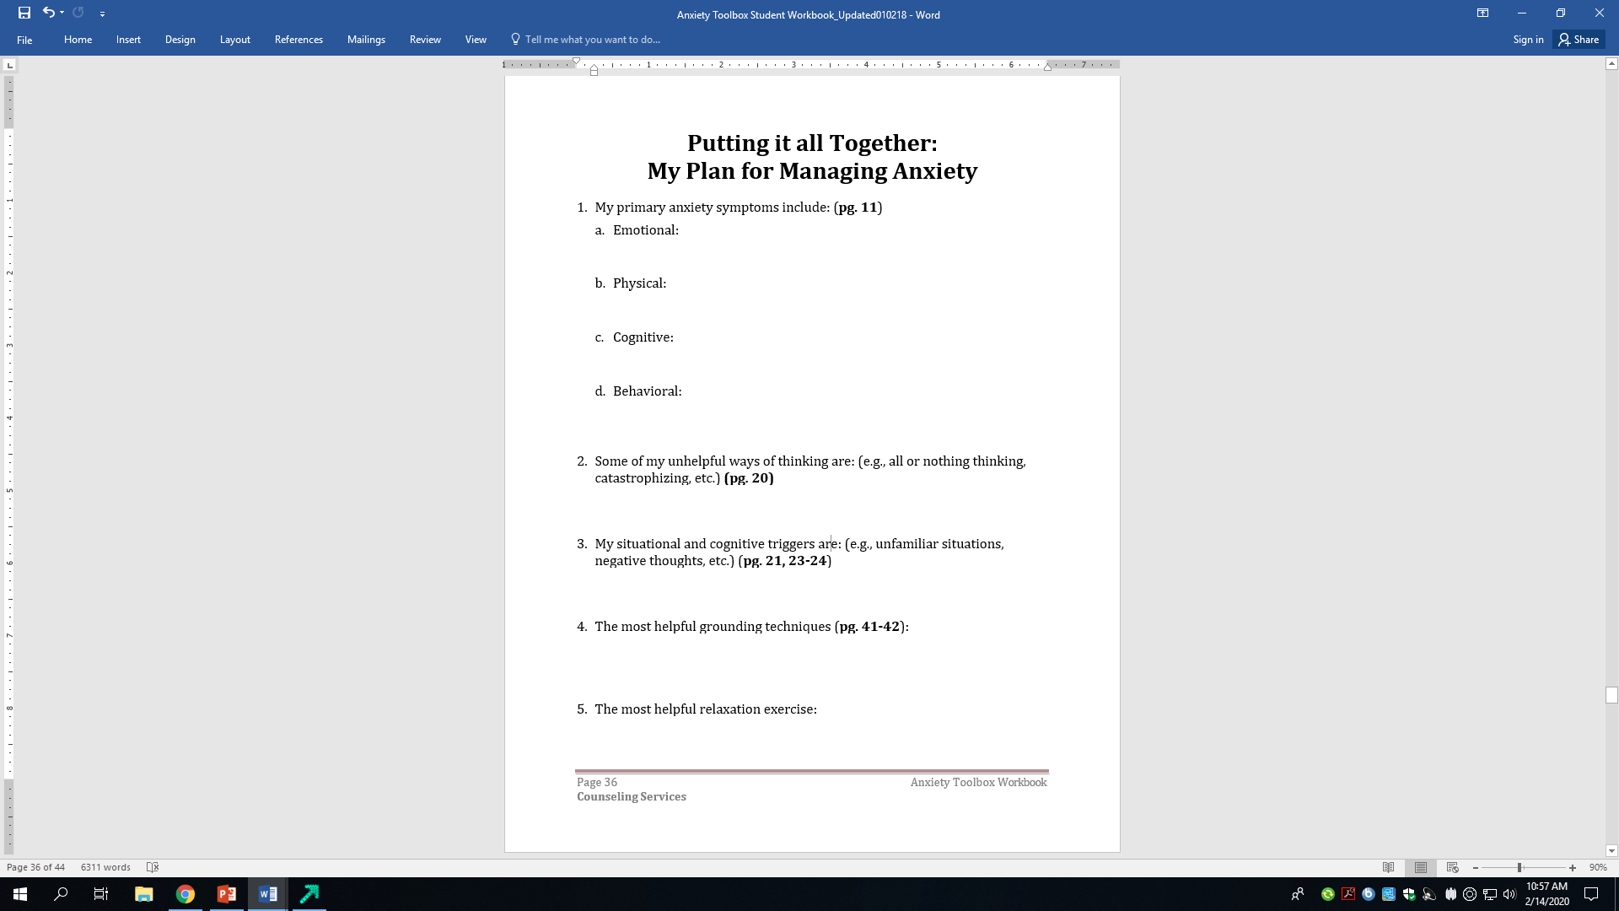
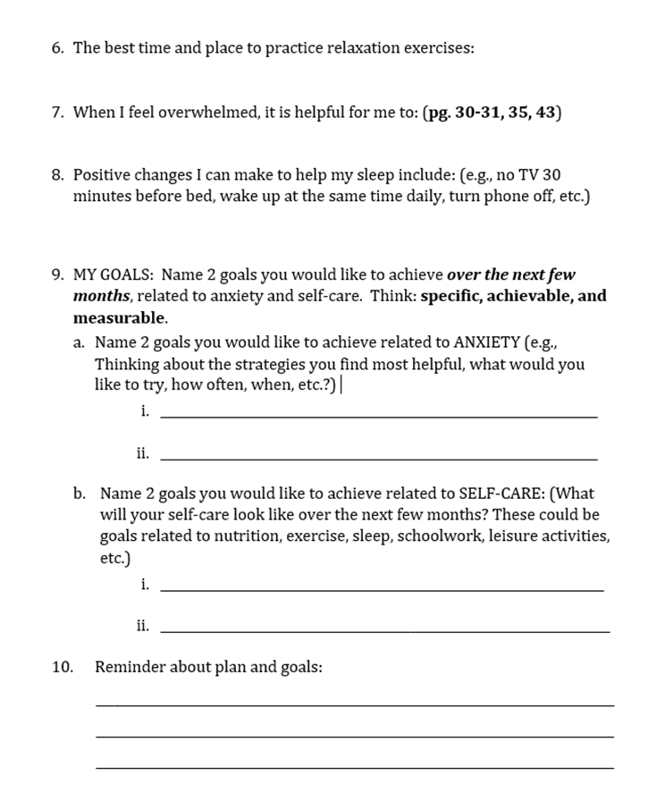
Putting it All Together – Making a Plan to Manage Anxiety
Pages 29-30, 34, 42
Page 8
Pages 18 & 19
Page 20
Pages 40-41

Slide 15
Anxiety Toolbox Summary
Some amount of anxiety is a normal part of the human experience, and can be helpful
Thoughts, feelings, physical symptoms and behaviors interact and can increase anxiety
Identifying triggers and unhelpful thinking styles are key in managing anxiety
Challenging unhelpful thoughts and practicing relaxation and coping strategies can help you effectively manage anxiety
The next step is to use your personalized action plan to practice these new skills and check out the resources at

